Slide 1
Introduction to Physics-Informed Machine Learning with Modulus
Notes:
Hello everyone and welcome to Introduction to Physics-Informed Machine with Modulus.
This course consists of two main components. The first is this presentation, which will introduce you to physics-informed machine learning concepts, and also to NVIDIA Modulus, the framework we will focus on to utilize the powerful techniques discussed in this course.
The second main component of this course are the interactive materials, which provide you with a GPU-accelerated programming environment and that will allow you both to explore the tools and techniques taught in this presentation, and to try your hand at coding exercises using Modulus in order to prepare you for work on your own projects.
You will find instructions for launching the interactive environment below, on the same page as this presentation. We recommend you watch this presentation in its entirety before proceeding to the interactive materials. Should you wish, you can refer back to this presentation at any point in time during your work. For your convenience, a copy of the slide deck used in this presentation, without the voice recording, is also available to you below, should you wish to quickly lookup a single slide at a later time.
With those details out of the way, let’s proceed to the main portion of the presentation.

Slide 2
Agenda
• | What is Modulus?
• | Modulus Architecture, Training
• | Physics informed neural networks in Modulus
• | Data informed neural networks in Modulus
• | Modulus other features and advancements
Notes:
We will begin with a high level description of what Modulus is, and what kinds of problems it seeks to help us solve. Next, we will look at some of the internals of Modulus to understand the flow of data, the architecture of Modulus and Training at a very high-level. Then we will look at some concrete examples of how Modulus can be used to setup a few simple problems using first the Physics informed approach and later the data informed approach. We will close off the session by looking at some of the Modulus features and advancements.
In the interactive portion of this course, you’ll have the chance to utilize most everything we cover in this presentation in your own sandboxed GPU-accelerated environment.

Slide 3
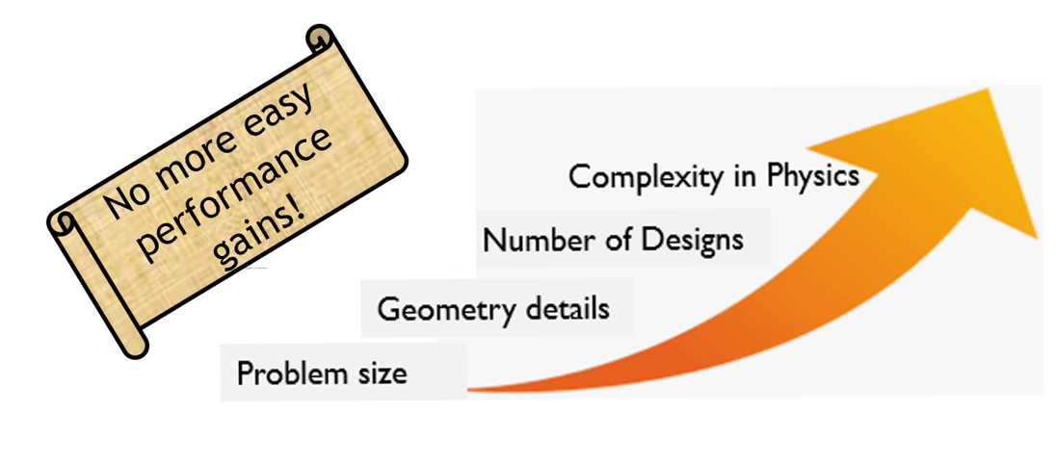
Saturating Performance in Traditional HPC
Simulations are getting larger and more complex
Traditional solution methods are:
Computationally Expensive
Plagued by Domain Discretization Techniques
Not suitable for Data-assimilation or Inverse problems
Notes:
Simulations are pervasive in every domain of science and engineering. However, they become computationally expensive as more geometry details are included and as model size, the complexity of physics or the number of design evaluations increases. Since large simulations sometimes take hours to days to complete a single run, the speed of iteration in the workflow is constrained by the speed of simulations. Supervised deep learning, which involves training on pre-existing simulation or experimental data offers one path to overcome this constraint. However, generating data can be expensive and very time consuming. Moreover, trained models may not obey the governing physics of the problem, involve extrapolation and generalization errors, and can provide unreliable results. In contrast with the traditional solvers, physics-driven neural network solvers can not only do parameterized simulations in a single run, but also address problems not solvable using traditional solver and data-driven models. With NVIDIA Modulus, we aim to tackle these problems.

Slide 4

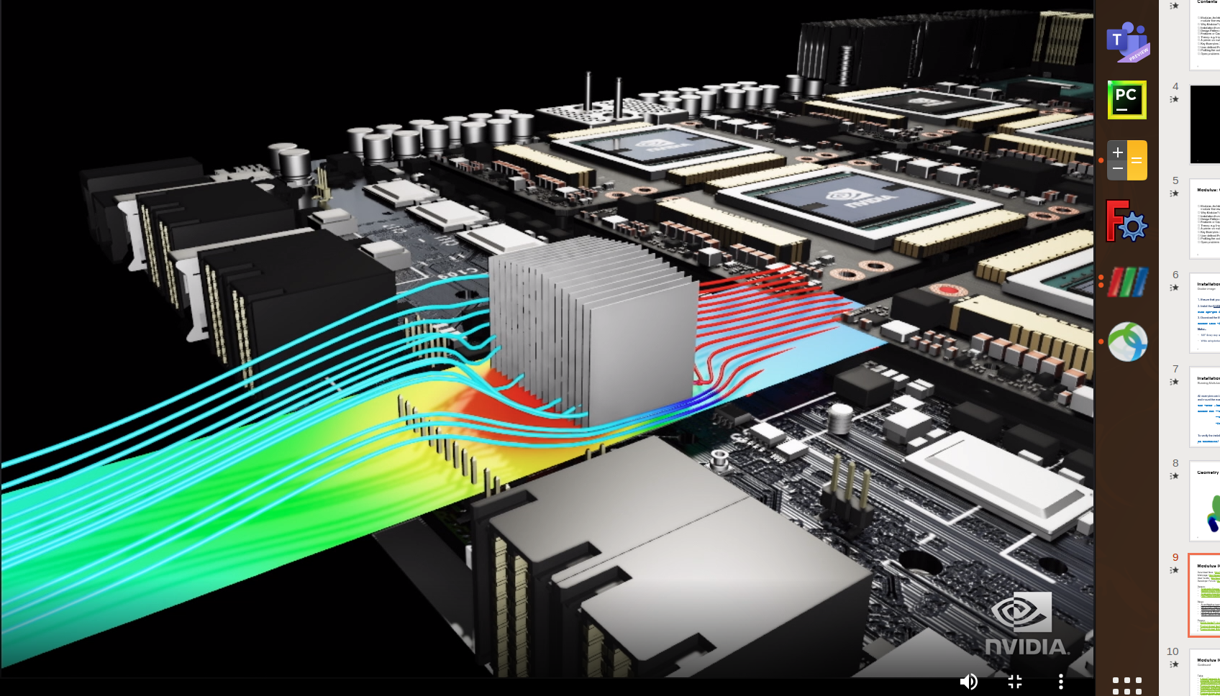

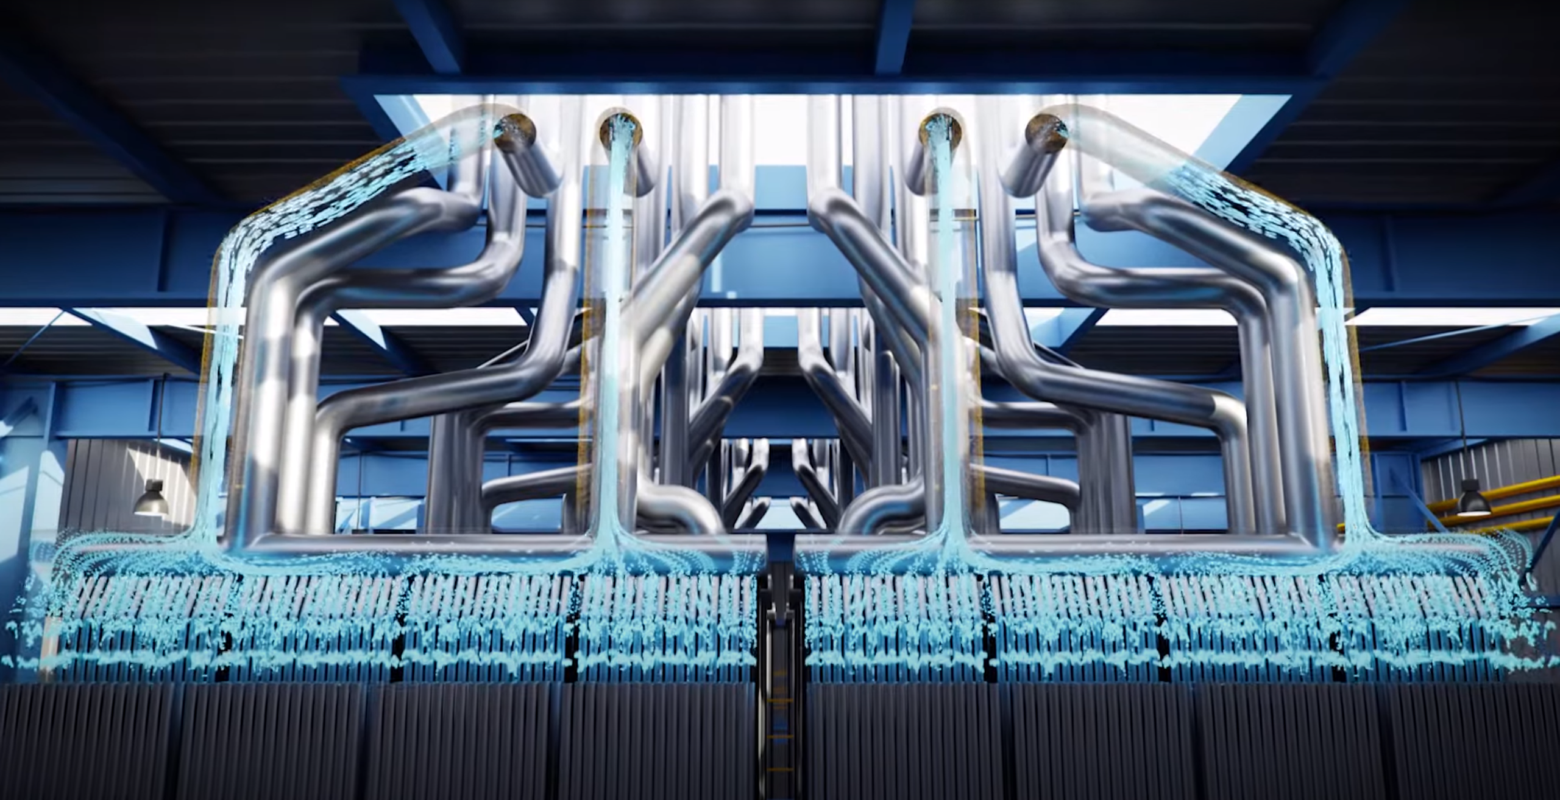
NVIDIA Modulus
NVIDIA Modulus is a neural network framework that blends the power of physics in form of governing partial differential equations (PDEs) with data to build high-fidelity, parameterized surrogate models with near-real-time latency. It offers:
AI Toolkit
Offers building blocks for developing physics-ML surrogate models
Scalable Performance
Solves larger problems faster by scaling from single GPU to multi-node implementation
Near-Real-Time Inference
Provides parameterized system representation that solves for multiple scenarios in near real time, trains once offline to infer in real time repeatedly
Easy Adoptability
Includes APIs for domain experts to work at a higher level of abstraction. Extensible to new applications with reference applications serving as starting points
Wind Farm Super Resolution
FPGA Heatsink Design Optimization
Extreme Weather Prediction
Industrial Digital Twin
Notes:
NVIDIA Modulus blends physics, as expressed by governing partial differential equations (PDEs), boundary conditions, and training data to build high-fidelity, parameterized, surrogate deep learning models with near-real-time latency. The platform abstracts the complexity of setting up a scalable training pipeline, so you can leverage your domain expertise to map problems to an AI model’s training and develop better neural network architectures. Available reference applications serve as a great starting point for applying the same principles to new use cases.
So, in a nutshell, Modulus is a platform that offers the building blocks for developing physics-ML surrogate models that bring together different methodologies such as PINNs and neural operators. It provides higher-level pythonic interface, abstracting the complexity of setting up training and inference pipelines. The framework is extensible to different domains and use cases, making it a great platform for AI innovation in engineering and scientific applications.
Modulus is built on NVIDIA AI stack, and that enables it to scale easily from simple canonical problems to complex real-world systems, naturally scaling up from single-GPU to multi-node implementations.
Modulus enable training parameterized physics-ML surrogate models that encapsulate the design and operating space of the underlying system, allowing you to infer multiple design points and scenarios in near real time. This is orders of magnitude faster than traditional simulations. You train once offline to infer in real time over and over.
And finally, Modulus is python based, and the high-level APIs make it easy for domain experts to work at a higher level of abstraction. The reference applications serve as great starting points for extending it to newer problems and domains leveraging the same underlying concepts to write new Python classes.
Here we showcase a few applications of Modulus. Modulus is used for variety of applications ranging from Wind Farm super resolution, design optimization of NVIDIA heatsinks, to Industrial digital twin applications and finally the FourCastNet which is an extreme weather prediction model developed within NVIDIA.

Slide 5
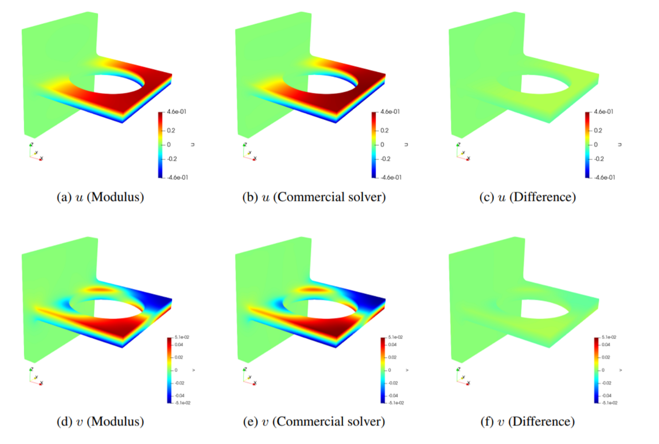
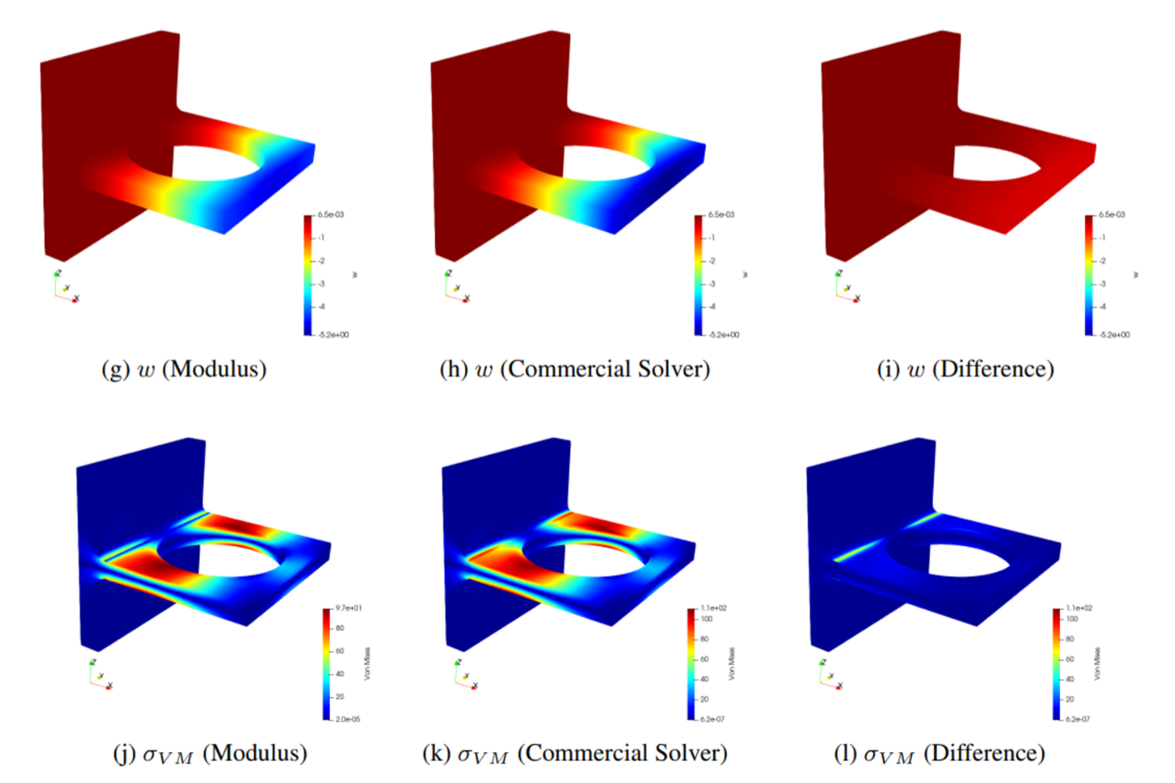
What is Modulus?
Modulus is a PDE solver
Like traditional solvers such as Finite Element, Finite Difference, Finite Volume, and Spectral solvers, Modulus can solve PDEs
A comparison between Modulus and commercial solver results for a bracket deflection example. Linear elasticity equations are solved here.
Notes:
Modulus can act like a traditional solver. Like finite element, finite difference, finite volume and spectral solvers, Modulus can take in the information about the governing PDEs, boundary condition and solve the system. Modulus can solve these PDEs in classical/strong form or variational/weak form. Here we show some comparisons between a commercial solver and Modulus for a linear elasticity case. Modulus can solve most of these PDEs on point-cloud representations that remove the need for complex mesh generation – which can be a very significant process in a traditional simulation workflow.

Slide 6
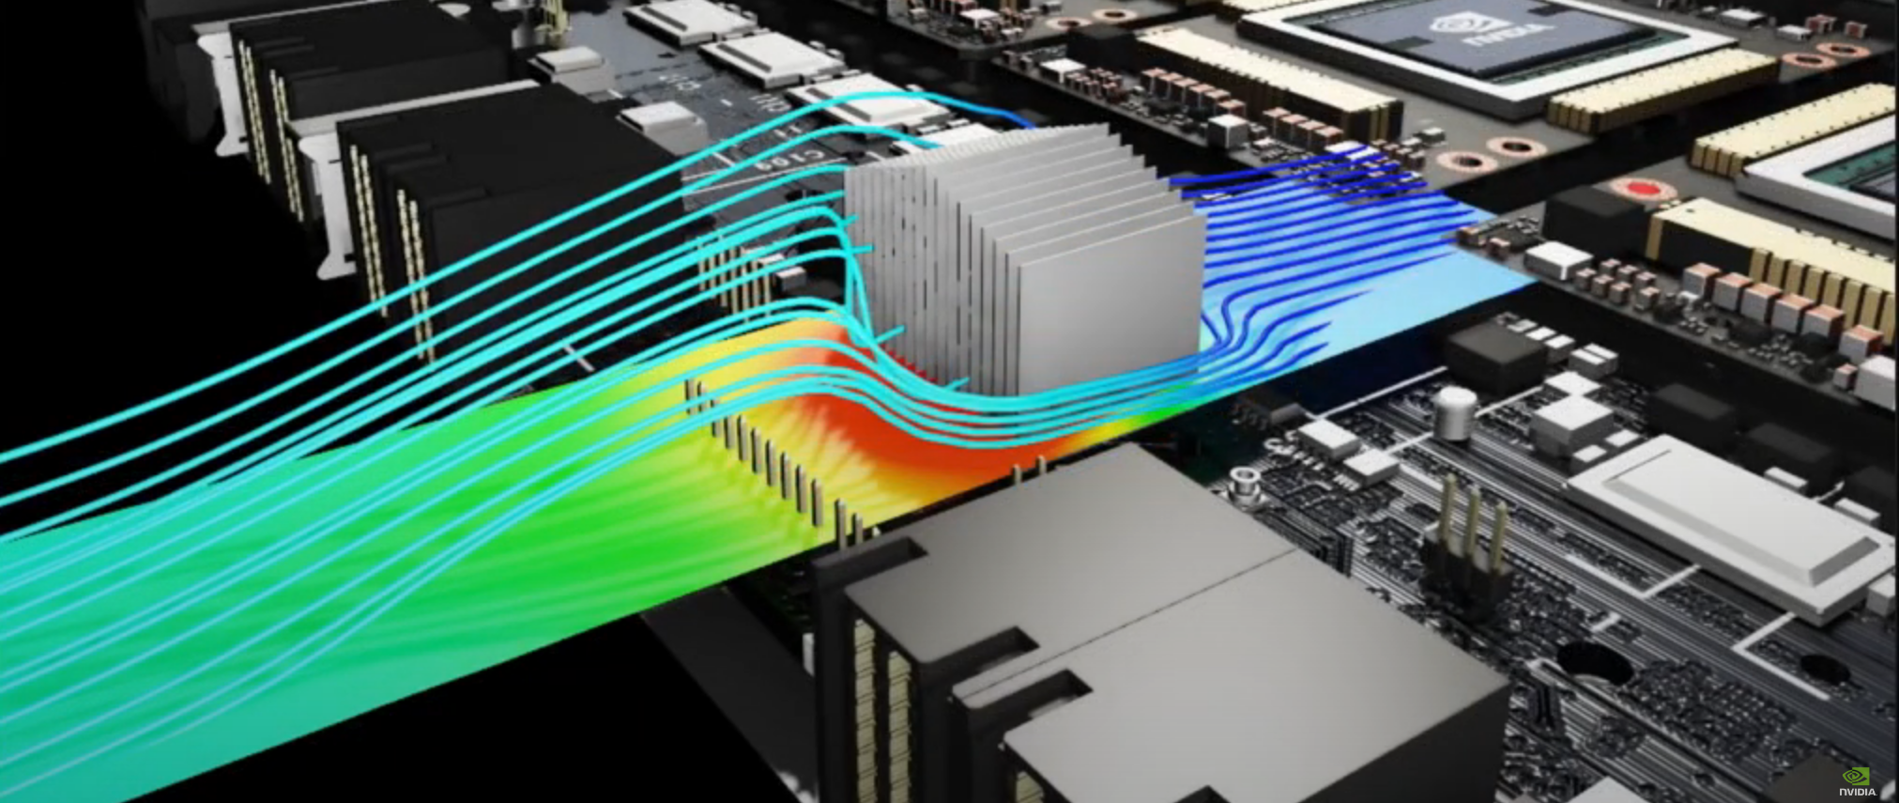
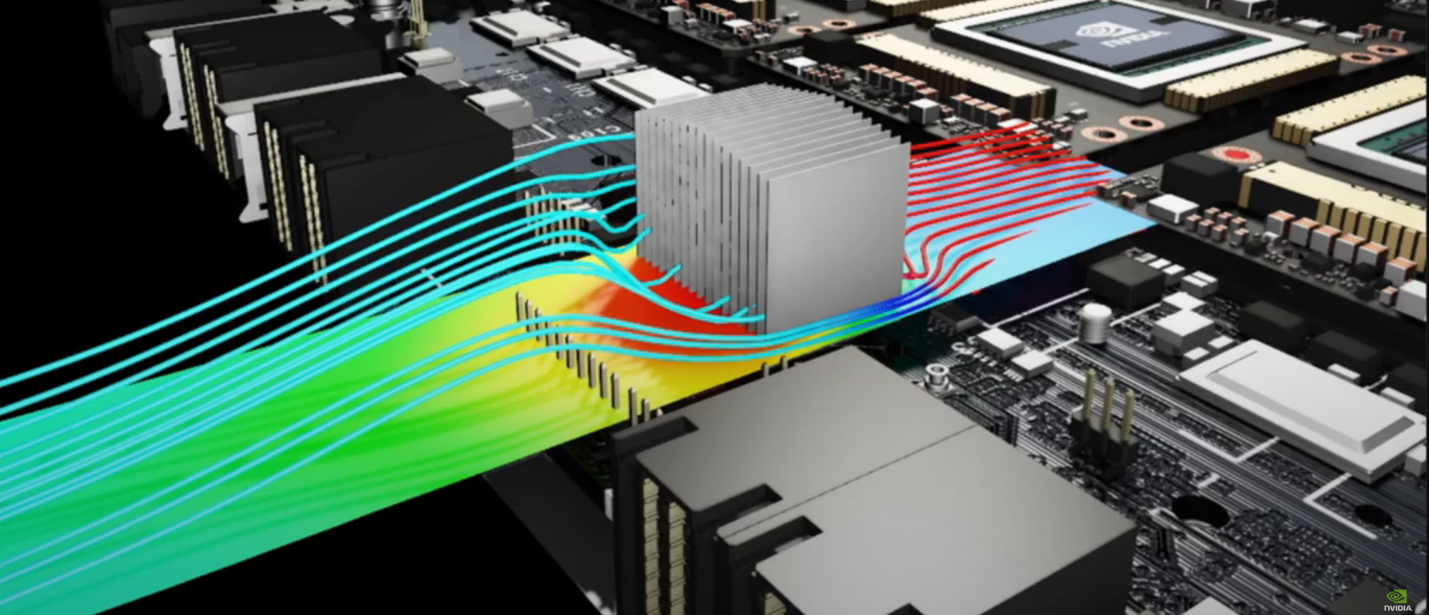
What is Modulus?
Modulus is a tool for efficient design optimization for multi-physics problems
With Modulus, professionals in Manufacturing and Product Development can explore different configurations and scenarios of a model, in near-real-time by changing its parameters, allowing them to gain deeper insights about the system or product, and to perform efficient design optimization of their products.
Efficient design space exploration of the heatsink of a Field-Programmable Gate Array (FPGA) using Modulus.
Notes:
Modulus offers several implicit and explicit ways to parameterize a problem. This allows professionals in Manufacturing and Product development to explore different configurations and scenarios of a model in near-real time by changing its parameters, allowing them to gain deeper insights about the system or product, and to perform efficient design optimization of their products. Internally within NVIDIA, Modulus is used for optimizing the performance of several heatsink components.

Slide 7
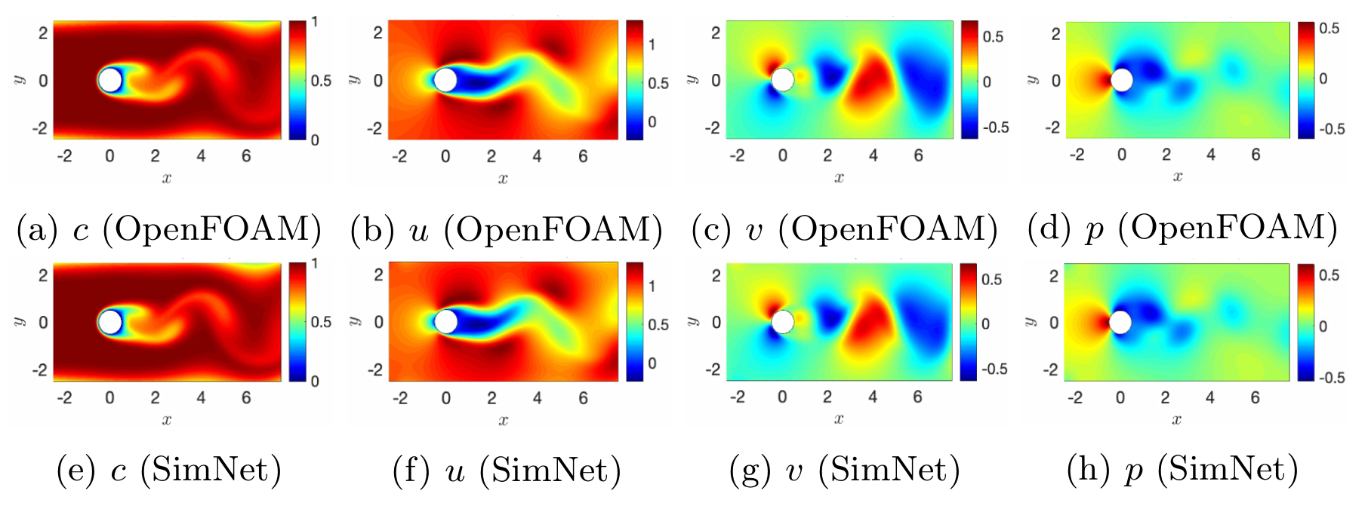
What is Modulus?
Modulus is a solver for inverse problems
Many applications in science and engineering involve inferring unknown system characteristics given measured data from sensors or imaging.
By combining data and physics, Modulus can effectively solve inverse problems.
(Modulus)
(Modulus)
(Modulus)
(Modulus)
A comparison between Modulus and OpenFOAM results for the flow velocity, pressure and passive scalar concentration fields. Modulus has inferred the velocity and pressure fields using scattered data from passive scalar concentration.
Notes:
Modulus is an effective tool to handle inverse problems in science and engineering. Many applications in this field require inferring unknown system characteristics given some measured data from sensors or imaging. By combining the data and physics, Modulus can effectively solve inverse problems. Several applications of this include finding the unknown terms in a PDEs, boundary conditions etc.

Slide 8


What is Modulus?
Modulus is a tool for developing digital twins
A digital twin is a virtual representation (a true-to-reality simulation of physics) of a real-world physical asset or system, which is continuously updated via stream of data.
Digital twin predicts the future state of the real-world system under varying conditions.
Virtual representation
Future state realizations
Notes:
Modulus is a tool to develop digital twins. A digital twin is a virtual representation (a true to reality simulation of physics) of a real-world physical asset or system, which is continuously updated via a stream of data. Digital twin predicts the future state of the real-world system under varying conditions. This has several applications in weather modeling and industrial use cases where the predictions need to be updated in near-real time based on the changing input conditions.

Slide 9

What is Modulus?
Modulus is a tool for developing data-driven solutions to engineering problems
Modulus contains a variety of APIs for developing data-driven machine learning solutions to challenging engineering systems, including:
Data-driven modeling of physical systems
Super resolution of low-fidelity results computed by traditional solvers
Super-resolution of flow in a wind farm using Modulus
Notes:
Modulus is a toolkit for developing data-driven solutions to engineering problems. Modulus contains a variety of APIs tailored to developing data-driven machine learning solutions to challenging engineering systems including data-driven modeling of physical systems, super resolution of low fidelity results computed by traditional solvers etc. Here an application of wind farm is shown where the High-resolution LES simulation is recreated using the Low-resolution input data.

Slide 10
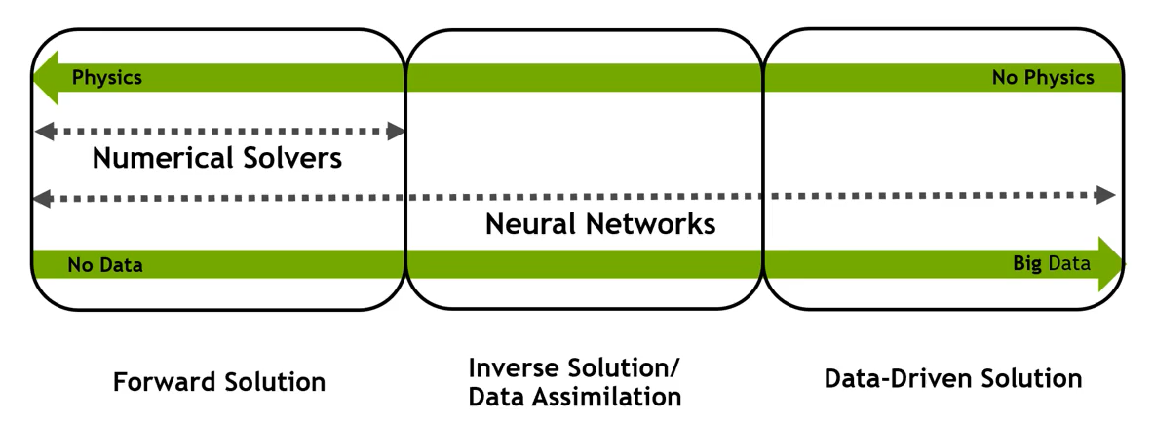
What is Modulus?
Putting it all together
Modulus is a PDE solver (category I)
Modulus is a tool for efficient design optimization & design space exploration (category I)
Modulus is a solver for inverse problems (category II)
Modulus is a tool for developing digital twins (category II)
Modulus is a tool for developing AI solutions to engineering problems (category III)
These are all done by developing deep neural network models in Modulus that are physics-informed and/or data-informed.
Category I
Category II
Category III
Notes:
So, to summarize, NVIDIA Modulus is a deep learning framework that blends the power of physics and partial differential equations (PDEs) with AI to build more robust models for better analysis. As we saw, there is a plethora of ways in which ML/NN models can be applied for physics-based systems. These can depend based on the availability of observational data and the extent of understanding of underlying physics. Based on these aspects, the ML/NN based methodologies can be broadly classified into forward (physics-driven), data-driven and hybrid approaches that involve both the physics and data assimilation.
With NVIDIA Modulus, we aim to provide researchers and industry specialists, various tools that will help accelerate your development of such models for the scientific discipline of your need.

Slide 11
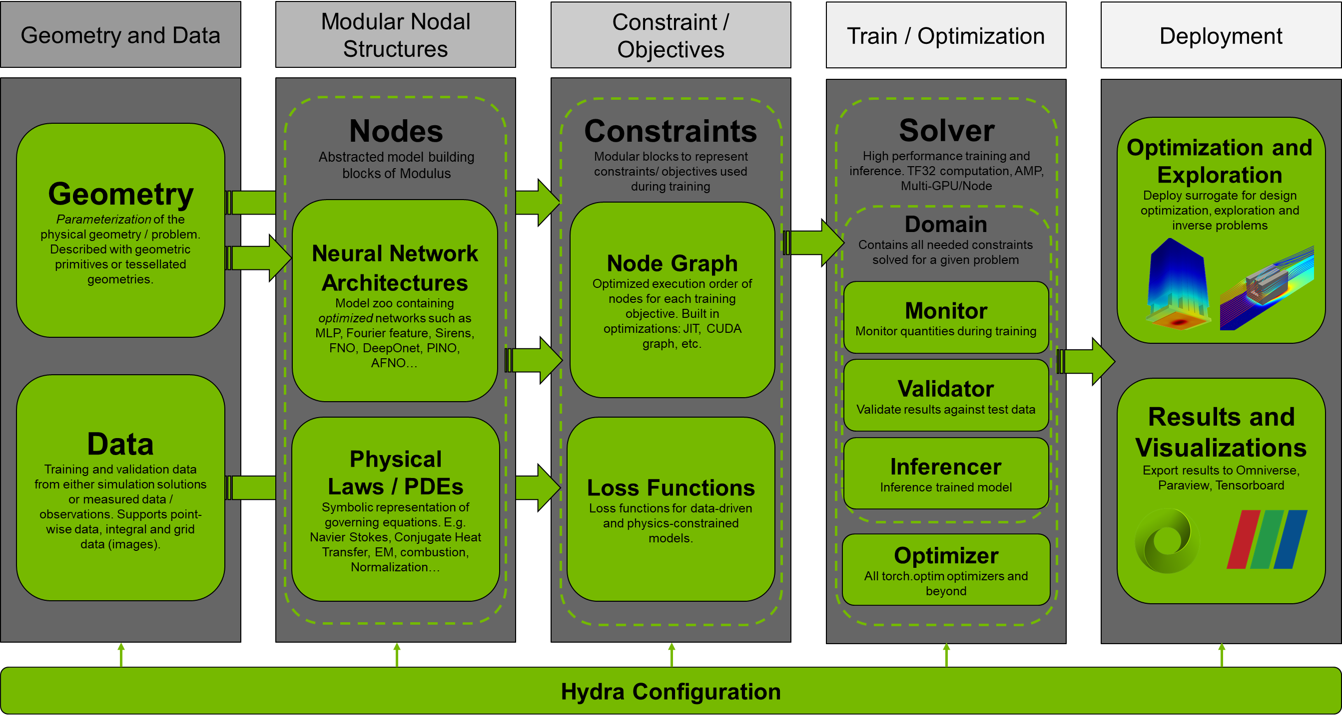
Modulus Architecture
Notes:
This slide shows the Modulus architecture. Modulus provides several APIs for generating or importing geometry for physics informed training as well as several dataloaders for efficient data loading for data-driven training. Modulus has several abstracted model building blocks that include a variety of neural network architectures popular in the community as well as implementations of several physical PDEs and equations to get started quickly. Modulus allows complex problems to be defined as training objectives or constraints, that handle the process of creating optimized execution order of nodes in the back end. Built-in optimizations like Just in time compilation or JIT, Cuda Graphs, etc, make the training faster. Losses for the data driven and physics-constrained models are also computed in the backend.
Modulus provides several Solver classes which are these high-performance training loops for training and inference. We will look at a Modulus training loop in detail in the next slide. It provides several optimizers to choose from for the optimizer and also several utilities to monitor the training performance. Finally, modulus provides flexibility in terms of visualizing the data and users can use several tools like Omniverse, Tensorboard, Paraview, etc. to interact with Modulus models.

Slide 12
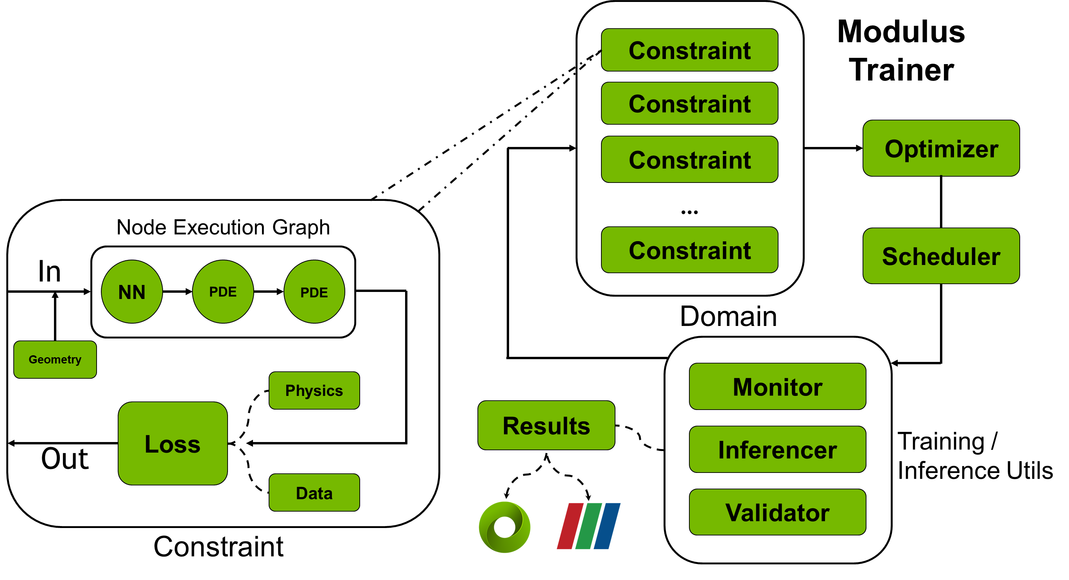
Modulus Training
Modulus allows for complex problems to be described through sets of constraints (training objectives)
Multiple nodes/models can be combined in constraints for learning different data-driven or physics-driven loss functions
Exporting results of the trained model to visualization software is then effortless with Modulus
Notes:
Here we describe the Modulus training loop. Modulus allows for complex problems to be described through sets of constraints / training objectives. Multiple nodes and models can be combined in constraints for learning different data-driven or physics-driven loss functions. Within a training iterations, the constraints are fed to a optimizer which computes the required gradients of the loss function and computes the required weight updates. The scheduler then changes the learning rate if required. At the end the training or inference utilities are executed for monitoring and then this loop repeats itself until the max_steps or a convergence criteria is reached.
Within each constraint, the geometry or data input is taken, the computation nodes are executed in an optimized order and the relevant physics or data loss is computed which is fed to the optimizer.

Slide 13
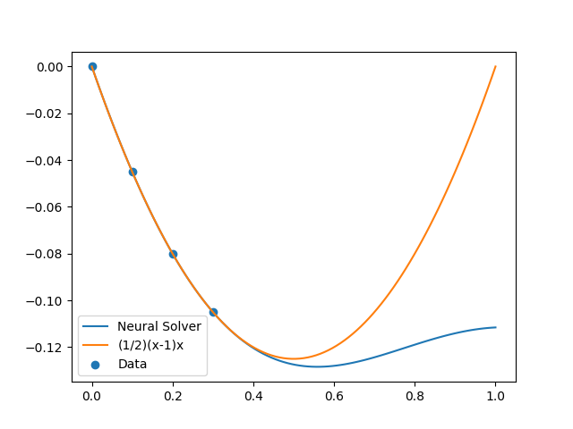
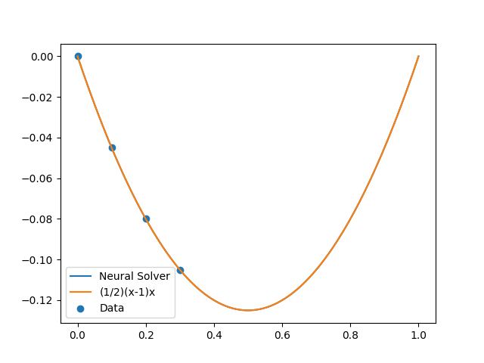
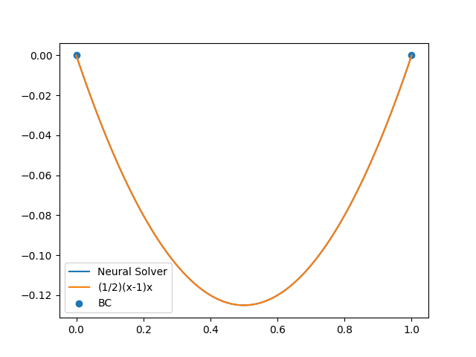
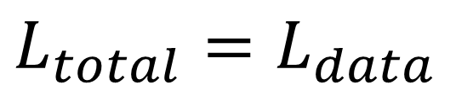
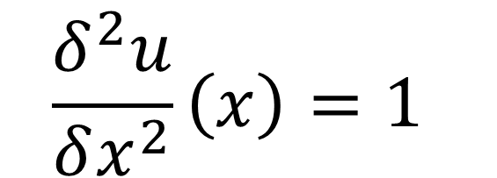
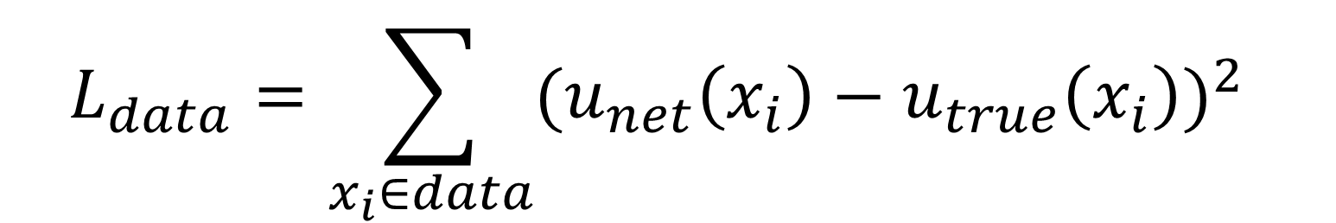
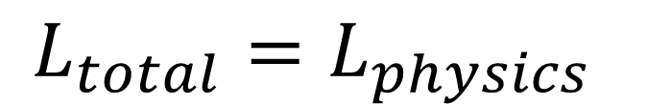
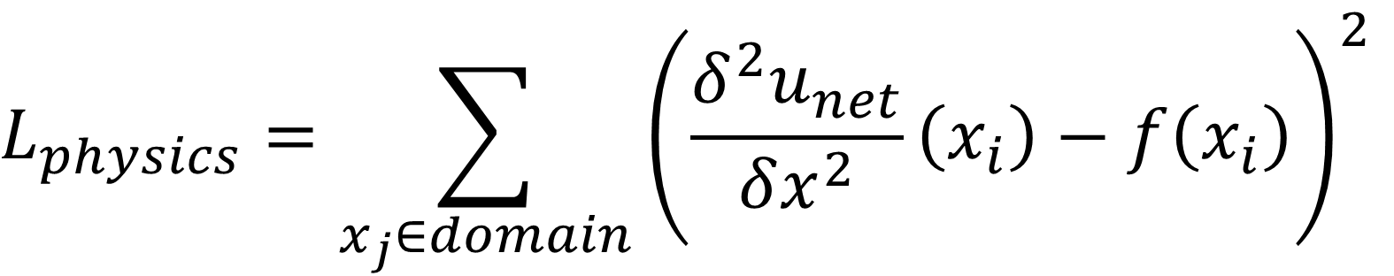
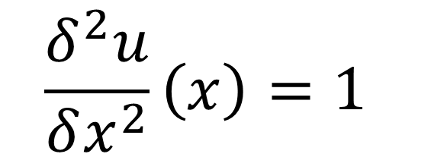
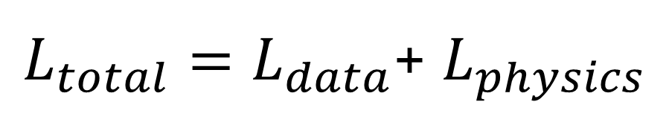
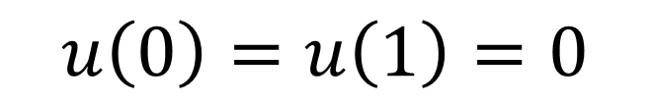
Physics Informed Neural Networks (PINNs) in Modulus
A problem with NNs and the promise of PINNs
Data Only
Data + Physics
Physics only
$$\frac{δ^{2}u}{δx^{2}}\left(x\right)=1$$
$$\frac{δ^{2}u}{δx^{2}}\left(x\right)=1$$
$$u\left(0\right)=u\left(1\right)=0$$
$$L_{data}=\sum_{x_{i}∈data}{{(u_{net}\left(x_{i}\right)−u_{true}\left(x_{i}\right))}^{2}}$$
$$L_{physics}=\sum_{x_{j}∈domain}{{\left(\frac{δ^{2}u_{net}}{δx^{2}}\left(x_{i}\right)−f\left(x_{i}\right)\right)}^{2}}$$
$$L_{physics}=L_{residual}+L_{BC}$$
$$L_{total}=L_{data}$$
$L_{total}=L_{data}$+ $L_{physics}$
$$L_{total}=L_{physics}$$
Notes:
With the architecture and training loop covered, you now have a good understanding of the Modulus internals. Now let’s look at the physics informed neural networks in Modulus. Since this concept is very different from the more canonical form or supervised Machine learning, where you have a set of labelled data that the model trains to predict, we will look at the theory behind solving PDEs using neural networks briefly. Before we dive into how we go about incorporating a partial differential equation in a neural network, lets consider a simple example. Here we consider a 2nd order differential equation using 3 different approaches.
On the left we can observe that when provided with just data, the network is able to interpolate between those data points very well, but gives a very poor prediction when extrapolated, in other words does not generalize very well to the solution. In the middle we can see that when the data is combined with a loss function that trains the network to satisfy a particular differential equation (soft constraint) can improve how the neural network performs even outside of the range of data it was provided (generalizes better). Finally, we can see that an extension of this idea can be a case where we do not rely on any data, but only the differential equation and the boundary conditions to make the problem well posed and the neural network is able to solve the solution to this differential equation. In this setting the it behaves as a neural solver.
Although these are simple examples to introduce the concept, these ideas can be extended to very complicated problems dealing with complex geometries, multi-physics governed by a variety of physics etc. as we saw before. Now let's dive deeper into what it takes to formulate these different scenarios.

Slide 14
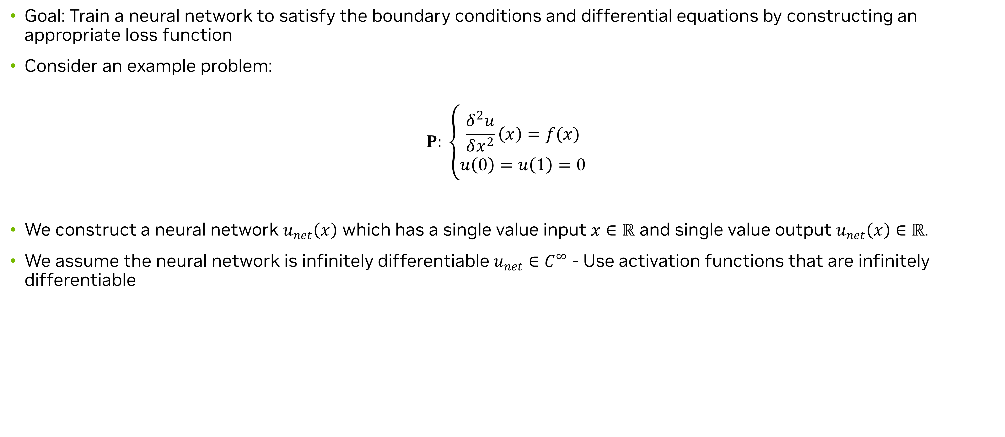
PINNs Theory: Neural Network Solver
Problem description
Goal: Train a neural network to satisfy the boundary conditions and differential equations by constructing an appropriate loss function
Consider an example problem:
$$P: \left\{\begin{aligned}\frac{δ^{2}u}{δx^{2}}\left(x\right)=f(x) \\ u\left(0\right)=u\left(1\right)=0\end{aligned}\right.$$
We construct a neural network $u_{net}\left(x\right)$ which has a single value input $x∈ℝ$ and single value output $u_{net}\left(x\right)∈ℝ$.
We assume the neural network is infinitely differentiable $u_{net}∈C^{∞}$ - Use activation functions that are infinitely differentiable
Notes:
Let’s consider the same differential equation from the previous slide and see how we can solve it completely using the physics/equations without any external training data. The goal here is to train a neural network to satisfy the boundary conditions and differential equations by constructing an appropriate loss function. If the network is able to minimize this loss function, then it will in effect, solve the given differential equation.
We start by constructing a neural network u_net​(x). The input to this network is a single value x∈R and its output is also a single value u_net​(x)∈R. We suppose that this neural network is infinitely differentiable, u_net​∈C∞. The typical neural network used is a deep fully connected network where the activation functions are infinitely differentiable.

Slide 15
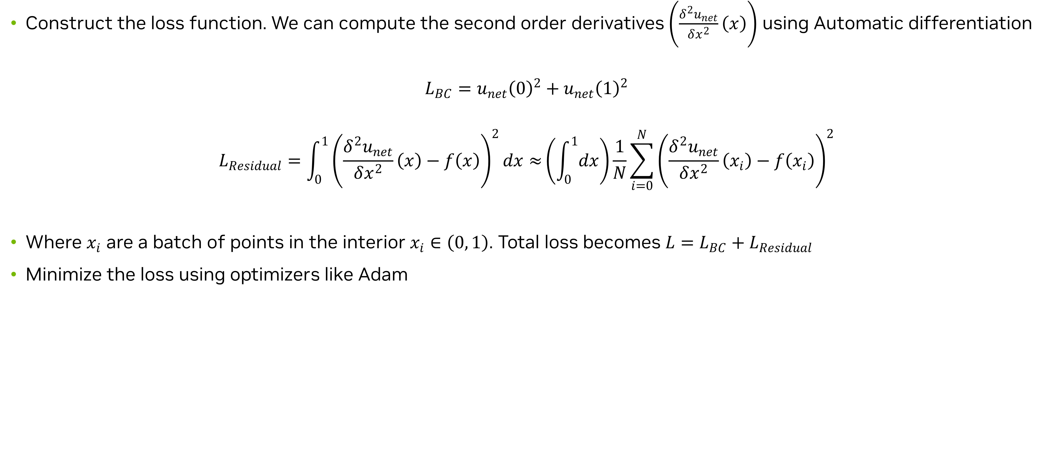
PINNs Theory: Neural Network Solver
Loss formulation
Construct the loss function. We can compute the second order derivatives $\left(\frac{δ^{2}u_{net}}{δx^{2}}\left(x\right)\right)$ using Automatic differentiation
$$L_{BC}=u_{net}{\left(0\right)}^{2}+u_{net}{\left(1\right)}^{2}$$
$$L_{Residual}=\int_{0}^{1}{{\left(\frac{δ^{2}u_{net}}{δx^{2}}\left(x\right)−f\left(x\right)\right)}^{2}dx≈}\left(\int_{0}^{1}{dx}\right)\frac{1}{N}\sum_{i=0}^{N}{{\left(\frac{δ^{2}u_{net}}{δx^{2}}\left(x_{i}\right)−f\left(x_{i}\right)\right)}^{2}}$$
Where $x_{i}$ are a batch of points in the interior $x_{i}∈\left(0, 1\right)$. Total loss becomes $L=L_{BC}+L_{Residual}$
Minimize the loss using optimizers like Adam
Notes:
Next, we need to construct a loss function to train this neural network. We easily encode the boundary conditions as a loss in the following way. Here we have formed the L2 loss for each of the boundary point. Since the desired value for the BC is 0, this can be thought of as minimizing the L2 value predicted by the u_net at each of these boundary points. For encoding the equations, we need to compute the derivatives of u_net​. Using automatic differentiation, we can do so and compute δx2δ2unet​​(x). This allows us to write a loss function of the form. Then using Monte-Carlo integration we can replace the integral with a summation as shown. Here the xi​'s are a batch of points sampled in the interior, xi​∈(0,1). Our total loss is then L=L_BC​+L_residual​. Optimizers such as Adam are used to train this neural network. This can be thought of as creating artificial data for the neural network to train on. The true value for each of the interior point is to have a zero residual of the equation and the true value for each point on the boundary condition is the value you specified.

Slide 16
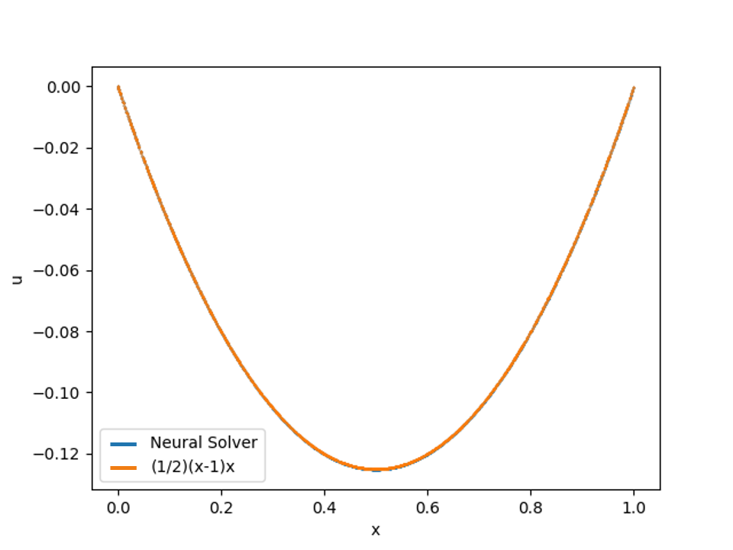
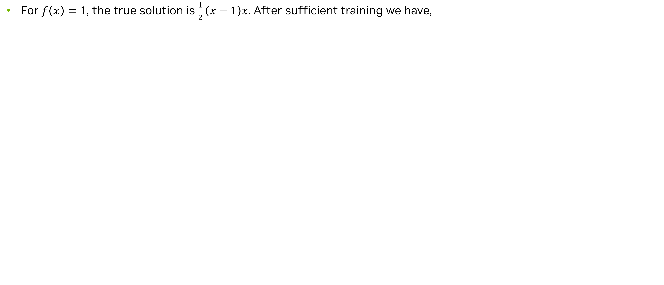
PINNs Theory: Neural Network Solver
Results
For $f\left(x\right)=1$, the true solution is $\frac{1}{2}\left(x−1\right)x$. After sufficient training we have,
Comparison of the solution predicted by Neural Network with the analytical solution
Notes:
Given f(x)=1, the true solution is 1/2​(x−1)x. Upon solving the problem, you can obtain good agreement between the exact solution and the neural network solution as shown in Figure below. Thus, we solved a differential equation completely using just the equation and boundary conditions using the neural networks.

Slide 17
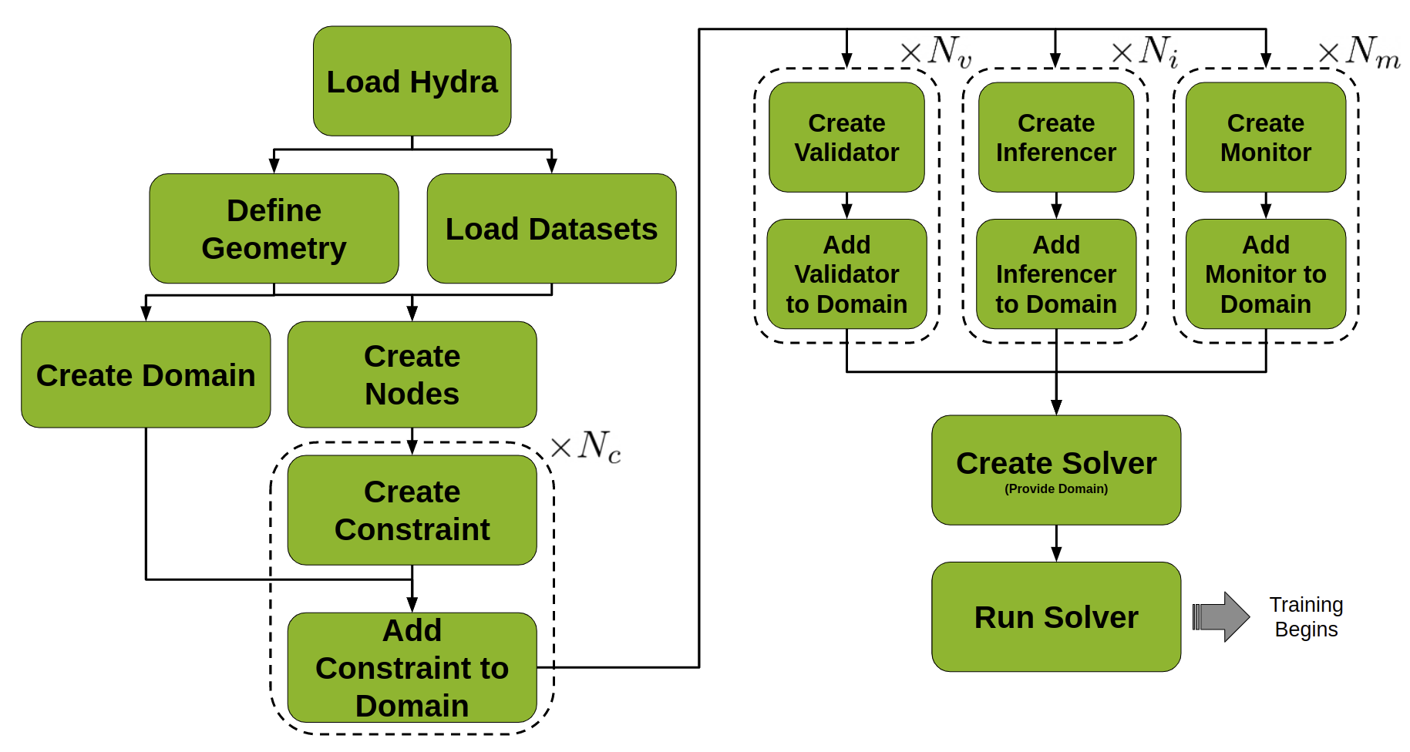
Modulus: Anatomy of a project
Overview
Modulus works by:
Writing models which include at least one adaptable function (a NN)
Writing objective functions as a combination of these models
Describing the geometry/dataset where the models should be evaluated
Minimizing the objective functions by using the provided data, by sampling the geometry, or both
Running the models to obtain the desired effect
Notes:
With that being covered, let’s look at how the theoretical ideas can be translated to code using Modulus APIs. Here we describe the brief anatomy of a Modulus project. While each problem has its own unique components, the general workflow when developing AI in Modulus follows the workflow in the figure below.
Distilling this process down into the key steps includes:
Initialize Hydra using the Modulus main decorator to read in the configuration YAML.
Load necessary data if needed.
Define the geometry of the system if needed.
Create any Nodes required, such as your neural network model.
Create a training Domain object.
Create constraints and add each to the domain.
Create any inferencers, validators or monitors needed.
Initialize a solver with the populated training domain.
Run the solver, beginning optimization.
Now let’s walk through each of these steps for this simple problem.

Slide 18
Modulus: Anatomy of a project
Load Hydra
defaults :
- modulus_default
- scheduler: tf_exponential_lr
- optimizer: adam
- loss: sum
- _self_
scheduler:
decay_rate: 0.95
decay_steps: 200
save_filetypes : "vtk,npz"
training:
rec_results_freq : 1000
rec_constraint_freq: 1000
max_steps : 5000
Notes:
Hydra is a configuration package that is built into the heart of Modulus. This allows for easy control over various hyperparameters using YAML files. For every problem being solved using Modulus, Hydra is the first component to be initialized and has direct influence on all component levels inside of Modulus. A typical configuration file for a modulus project is shown here. You can use the config file to change a variety of training parameters like the learning rate, max_steps, etc. The configs can also be used for defining more custom configs as well. Having the configs set in this form allows for easy hyper-parameter search – something that is critical in training the neural networks. Here we look at a very minimal example of hydra config for this problem. We define the optimizer as Adam, the learning rate scheduler as exponential decay. We also specify the decay rate and the decay steps. Some other configs defined include the max_steps, the frequency at which we want to record the results, the output format for the results etc.

Slide 19
Modulus: Anatomy of a project
Create geometry, domain and nodes
@modulus.main(config_path="conf", config_name="config")
def run(cfg: ModulusConfig) -> None:
# make geometry
x = Symbol("x")
geo = Line1D(0, 1)
# make list of nodes to unroll graph on
eq = CustomPDE(f=1.0)
u_net = FullyConnectedArch(
input_keys=[Key("x")],
output_keys=[Key("u")],
nr_layers=3,
layer_size=32
)
nodes = (eq.make_nodes() + [u_net.make_node(name="u_network")])
# make domain
domain = Domain()
Notes:
For this purely physics driven case, we won't use any external training data. Instead, we will create some geometry that we can use to sample the various collocation points needed to impose the boundary and equation losses we saw earlier in the theory. Modulus has several geometry objects to choose from ranging from 1D shapes like Point1D, Line1D to more complex 3D ones like Torus, Tetrahedron etc. Let's use the Line1D object for this example to sample the required points.
Next, we will create the nodes required for our problem. These include the neural network itself (which acts as an adaptable function) and any equations that are used to formulate the PDE loss functions. The neural network used here is a simple fully connected neural network with 3 layers and 32 neurons in each layer. Modulus also provides a library of more advanced neural networks for handling more complicated problems.
Modulus allows you to quickly write your equations in the most natural way possible. The Sympy equations are converted to PyTorch expressions in the back-end and can also be printed to ensure correct implementation. For the sake of brevity, we don’t cover the definition of this custom PDE in this slide, but its definition can be found in the supplementary Jupyter Notebook. Modulus also comes with several common PDEs predefined for the user to choose from. Some of the PDEs that are already available in the PDEs module are: Navier Stokes, Linear Elasticity, Advection Diffusion, Wave Equations, etc.

Slide 20
Modulus: Anatomy of a project
Add constraints
# add constraints to solver
# bcs
bc = PointwiseBoundaryConstraint(
nodes=nodes,
geometry=geo,
outvar={"u": 0},
batch_size=2,
)
domain.add_constraint(bc, "bc")
# interior
interior = PointwiseInteriorConstraint(
nodes=nodes,
geometry=geo,
outvar={"custom_pde": 0},
batch_size=100,
bounds={x: (0, 1)},
)
domain.add_constraint(interior, "interior")
Notes:
As described earlier, we need to define a domain for training our neural network. The Domain holds all constraints as well as additional components needed in the training process. These additional components include inferencers, validators, and monitors. When developing in Modulus, constraints that the user defines are then added to the Domain to create a collection of training objectives. The Domain and the configs are then passed as inputs when using the Solver class.
Now let’s look into adding constraints to this domain. This can be thought of as adding specific constraints or training objectives to the neural network optimization. For this physics-driven problem, these constraints are the boundary conditions and equation residuals. The goal is to satisfy the boundary conditions exactly, and have the PDE residuals to go 0. These constraints can be specified within Modulus using classes like PointwiseBoundaryConstrant and PointwiseInteriorConstraint. A L2 loss is then constructed from these constraints which is used by the optimizer to minimize on. Specifying the constraints in this fashion is called soft-constraints.
Looking into each of these in detail:
For generating a boundary condition, we need to sample the points on the required boundary/surface of the geometry, specify the nodes we would like to unroll/evaluate on these points and then assign them the desired values. A geometry object’s boundary can be sampled using PointwiseBoundaryConstraint class. This will sample the entire boundary of the geometry we specify in the geometry argument, in this case, both the endpoints of the 1d line. A particular boundary of the geometry can be sub-sampled by using a particular criterion using the criteria argument. We will see its use in a later example. The desired values for the boundary condition are listed as a dictionary in outvar argument. These dictionaries are then used when unrolling the computational graph (specified using the nodes argument) for training. The number of points to sample on each boundary are specified using the batch_size argument.
Next, the Custom PDE we defined is enforced on all the points in the interior. We will use PointwiseInteriorConstraint class to sample points in the interior of the geometry. Again, the appropriate geometry is specified in the geometry argument; the equations to solve are specified as a dictionary input to outvar argument. These dictionaries are then used when unrolling the computational graph (specified using the nodes argument) for training. For this problem we have the 'custom_pde':0. The argument bounds, determines the range for sampling the values for variables.

Slide 21
Modulus: Anatomy of a project
Create utils to visualize the results and run the solver
# add inferencer
x_np = np.linspace(0, 1.0, 100).reshape(-1,1)
inference = PointwiseInferencer(
nodes=nodes,
invar={"x": x_np},
output_names=["u"],
)
domain.add_inferencer(inference, "inf_data")
# make solver
slv = Solver(cfg, domain)
# start solver
slv.solve()
if __name__ == "__main__":
run()
python <script_name>.py
mpirun –np <#GPU> <script_name>.py
Notes:
Next, we will create some utilities to visualize the results and run the solver. We can create some inferencer object to visualize our results. Then we create a solver by using the domain we just created along with the other configurations that define the optimizer choices, settings (i.e. conf) using Modulus’ Solver class. The solver can then be executed using the solve method. That completes the definition of a Modulus project for this simple problem. Once the script is defined, it can be executed by simply running the script as shown. This will start the training and finish once the max_steps has reached. At the end of the run, you can visualize the results from the inferencers to check the results. The post-processing steps are covered in detail in the supplementary Jupyter notebooks. Going from a single GPU to a multi-GPU run is also very simple and one can simply run the script using mpirun as shown here.

Slide 22
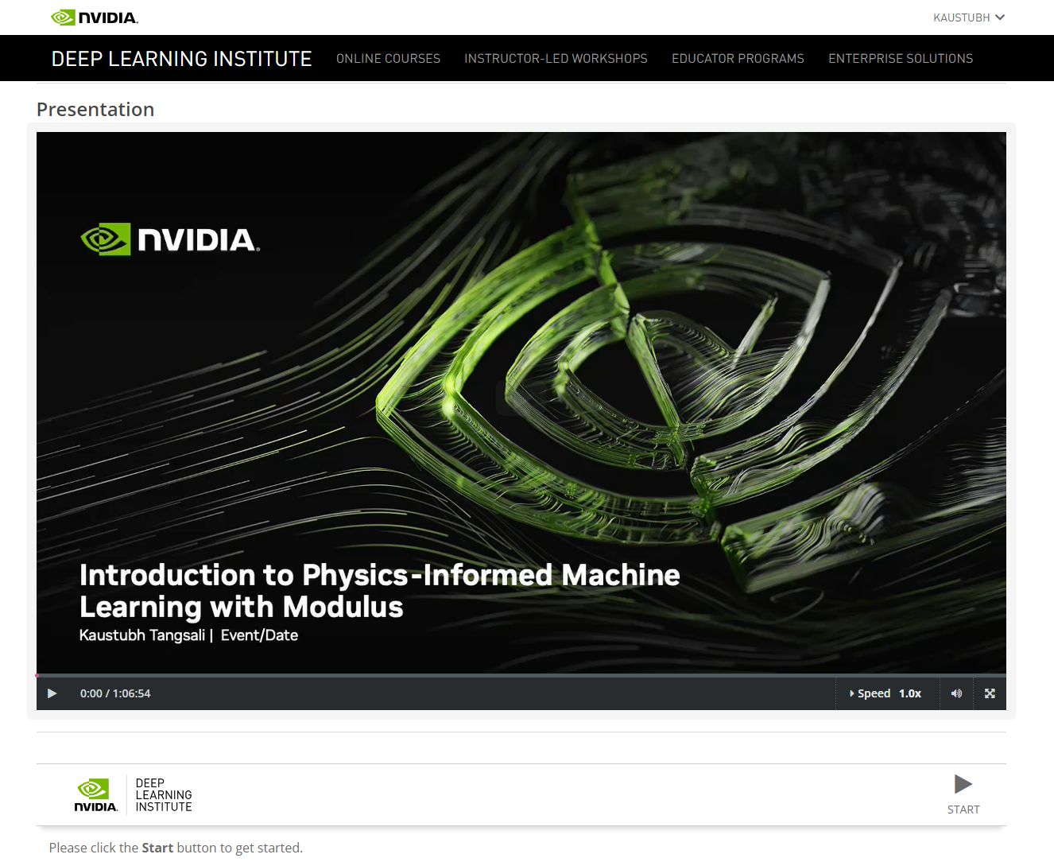
Accessing the supplemental material
DLI Interface and JupyterLab
Navigate to the course website and begin the course
At the bottom of the presentation, you will find a Start button which you can use to launch the interactive environment
The environment may take a few minutes to get started. Once started click the Launch button
You can now use this environment to run the examples provided on GPU
Feel free to make any modifications to the examples and see how the training performs
Notes:
Now let’s have a look at how we can interact with the notebooks and code that is provided with this course.

Slide 23
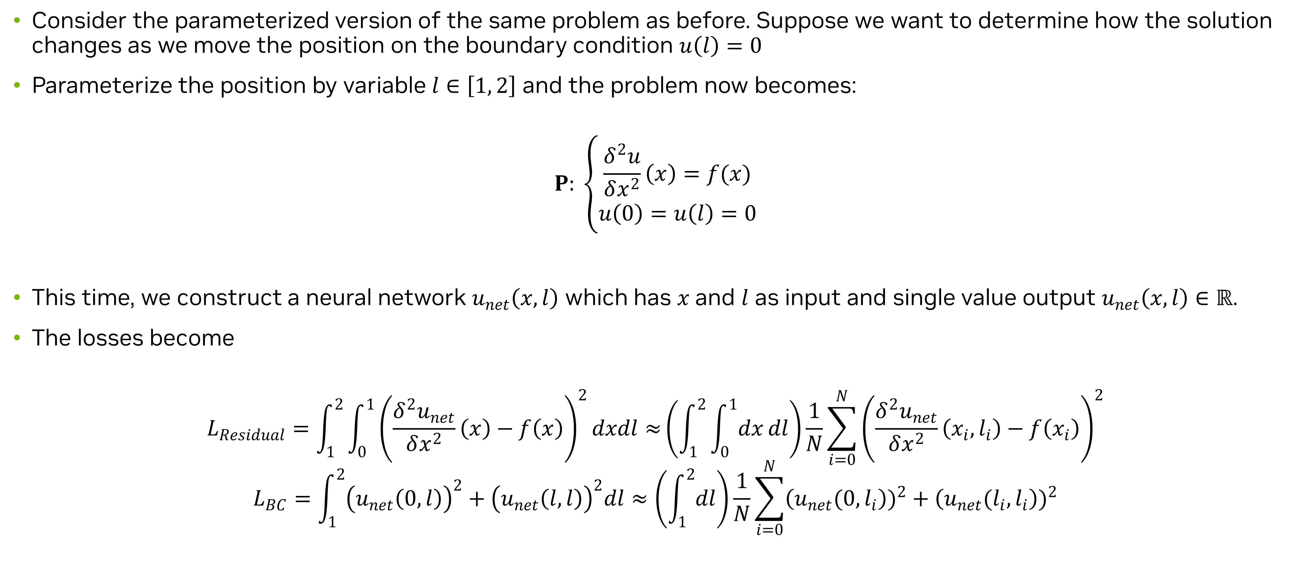
Solving Parameterized Problems
Problem definition
Consider the parameterized version of the same problem as before. Suppose we want to determine how the solution changes as we move the position on the boundary condition $u\left(l\right)=0$
Parameterize the position by variable $l∈\left[1, 2\right]$ and the problem now becomes:
$$P: \left\{\begin{aligned}\frac{δ^{2}u}{δx^{2}}\left(x\right)=f(x) \\ u\left(0\right)=u\left(l\right)=0\end{aligned}\right.$$
This time, we construct a neural network $u_{net}\left(x, l\right)$ which has $x$and $l$ as input and single value output $u_{net}\left(x, l\right)∈ℝ$.
The losses become
$$L_{Residual}=\int_{1}^{2}{\int_{0}^{1}{{\left(\frac{δ^{2}u_{net}}{δx^{2}}\left(x\right)−f\left(x\right)\right)}^{2}dxdl≈}}\left(\int_{1}^{2}{\int_{0}^{1}{dx}dl}\right)\frac{1}{N}\sum_{i=0}^{N}{{\left(\frac{δ^{2}u_{net}}{δx^{2}}\left(x_{i}, l_{i}\right)−f\left(x_{i}\right)\right)}^{2}}$$
$$L_{BC}=\int_{1}^{2}{{\left(u_{net}\left(0, l\right)\right)}^{2}+{\left(u_{net}\left(l, l\right)\right)}^{2}dl}≈\left(\int_{1}^{2}{dl}\right)\frac{1}{N}\sum_{i=0}^{N}{{\left(u_{net}(0, l_{i}\right))}^{2}+{\left(u_{net}(l_{i}, l_{i}\right))}^{2}}$$
Notes:
Now that we also took a dive into Modulus code for the simple problem, let’s explore some advantages of solving the differential equations using PINNs.
One such important advantage of a neural network solver over traditional numerical methods is its ability to solve parameterized geometries. To illustrate this concept, we solve a parameterized version of the above problem. Suppose we want to know how the solution to this equation changes as we move the position on the boundary condition u(l)=0. We can parameterize this position with a variable L which we can vary between 1 to 2, and our equation now has the form as shown here. To solve this parameterized problem, we can have the neural network take l as an extra input such that u_net is a function of x and L. The losses then take the form as shown here. Notice the extra parameter L added to the integrals. The points are now sampled in the space of x and l as opposed to only x as seen before.

Slide 24
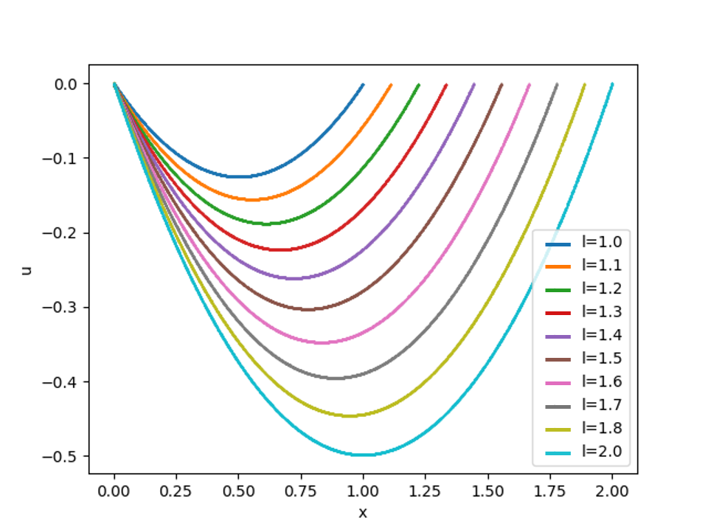

Solving Parameterized Problems
Results
For $f\left(x\right)=1$, for different values of $l$ we have different solutions
Solution to the parametric problem
Notes:
In figure below we see the solution to the differential equation for various l values after optimizing the network on this loss. While this example problem is overly simplistic, the ability to solve parameterized geometries presents significant industrial value. Instead of performing a single simulation we can solve multiple designs at the same time and for reduced computational cost. We will cover code for such problems in subsequent slides.
Also, more examples of this can be found in Modulus User Documentation.

Slide 25
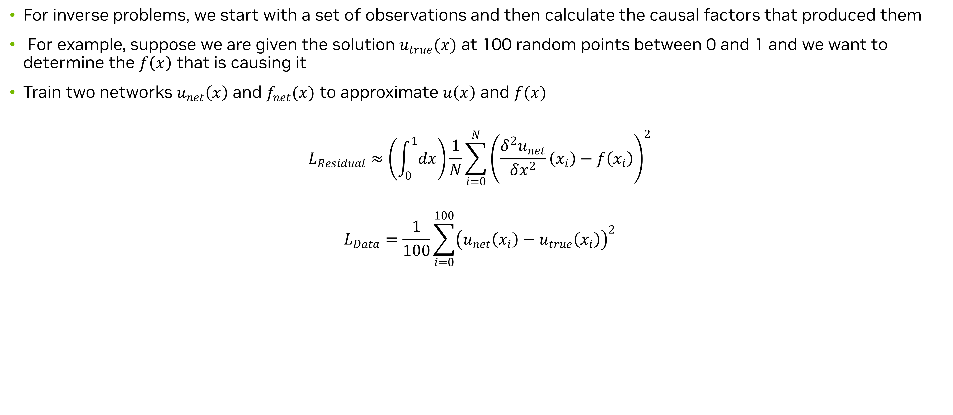
Solving Inverse Problems
Problem definition
For inverse problems, we start with a set of observations and then calculate the causal factors that produced them
For example, suppose we are given the solution $u_{true}(x)$ at 100 random points between 0 and 1 and we want to determine the $f\left(x\right)$ that is causing it
Train two networks $u_{net}\left(x\right)$ and $f_{net}(x)$ to approximate $u\left(x\right)$ and $f(x)$
$$L_{Residual}≈\left(\int_{0}^{1}{dx}\right)\frac{1}{N}\sum_{i=0}^{N}{{\left(\frac{δ^{2}u_{net}}{δx^{2}}\left(x_{i}\right)−f\left(x_{i}\right)\right)}^{2}}$$
$$L_{Data}=\frac{1}{100}\sum_{i=0}^{100}{{\left(u_{net}\left(x_{i}\right)−u_{true}\left(x_{i}\right)\right)}^{2}}$$
Notes:
Another useful application of a neural network solver is solving inverse problems. In an inverse problem, we start with a set of observations and then use those observations to calculate the causal factors that produced them. To illustrate how to solve inverse problems with a neural network solver, we give the example of inverting out the source term f(x) from same equation we have been considering so far. Suppose we are given the solution u_true​(x) at 100 random points between 0 and 1 and we want to determine the f(x) that is causing it. We can do this by making two neural networks u_net​(x) and f_net​(x) to approximate both u(x) and f(x). These networks are then optimized to minimize the following two losses; data and residual. The data loss trains the network to assimilate the data or the solution while the residual loss enforces the PDE constraint. The network can then use both of these constraints to invert out the unknows in the PDE.

Slide 26
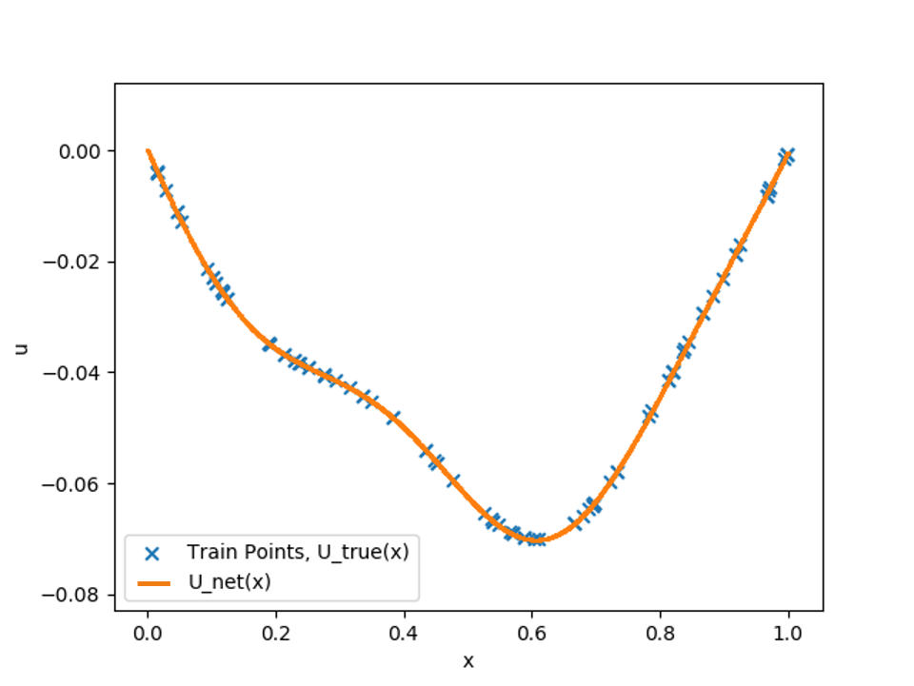
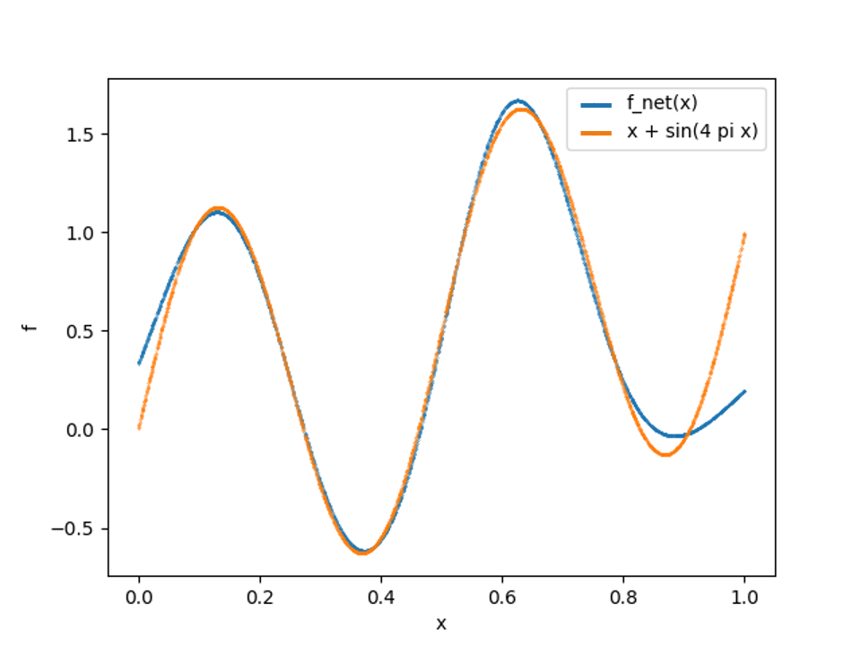
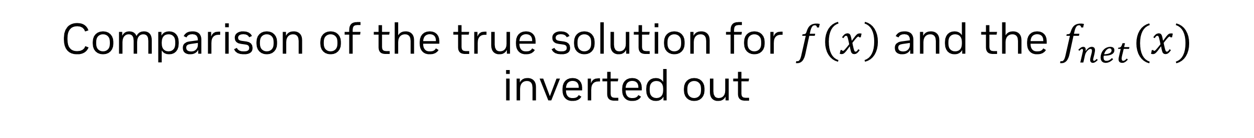

Solving Inverse Problems
Results
For $u_{true}\left(x\right)=\frac{1}{48}\left(8x\left(−1+x^{2}\right)−\frac{3\sin\left(4πx\right)}{π^{2}}\right)$ the solution for $f(x)$ is $x+\sin{(4πx)}$
Comparison of 𝑢_𝑛𝑒𝑡 (𝑥) and train points from 𝑢_𝑡𝑟𝑢𝑒
Comparison of the true solution for $f\left(x\right)$ and the $f_{net}(x)$ inverted out
Notes:
For f(x) equal to x+sin(4πx) we know analyticall that the utrue​(x) is as shown above. Now, if we use this true solution as the input to the neural network, without adding the information about f(X), we can invert out the f(X). Here on the left we see that the network is able to assimilate the true solution correctly. And also invert out the source term f(x) on the right.
The scripts and jupyter notebooks for all these simple problems are present in the supplemental material for you to access. You are encouraged to review the code for these different variants.

Slide 27
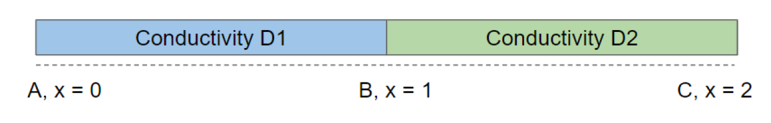
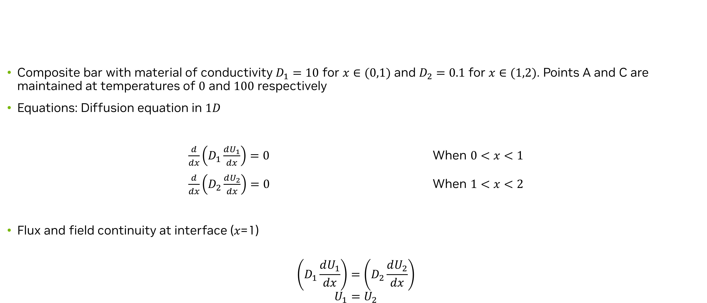
Solution to 1D diffusion
Problem description
Composite bar with material of conductivity $D_{1}=10$ for $x∈(0,1)$ and $D_{2}=0.1$ for $x∈(1,2)$. Points A and C are maintained at temperatures of $0$ and $100$ respectively
Equations: Diffusion equation in $1D$
$\frac{d}{dx}\left(D_{1}\frac{dU_{1}}{dx}\right)=0$ When $0<x<1$
$\frac{d}{dx}\left(D_{2}\frac{dU_{2}}{dx}\right)=0$ When $1<x<2$
Flux and field continuity at interface (𝑥=1)
$$\left(D_{1}\frac{dU_{1}}{dx}\right)=\left(D_{2}\frac{dU_{2}}{dx}\right)$$
$$U_{1}=U_{2}$$
Notes:
Let’s now look at some slightly more complex examples in detail. The PDE considered here is a diffusion equation. Diffusion equation is a parabolic partial differential equation and in physics it used to model changes in concentration of a quantity of interest inside a specified region with respect to spatial and temporal variables. For this case we consider the thermal diffusion in a composite bar. Our aim is to obtain the temperature distribution inside the bar that is made up of two materials with different thermal conductivity. The geometry and the problem specification of the problem can be seen in the figure here.
The composite bar extends from x=0 to x=2. The bar has material of conductivity D1​=10 from x=0 to x=1 and D2​=0.1 from x=1 to x=2. Both the ends of the bar, x=0 and x=2 are maintained at a constant temperatures of 0 and 100 respectively. For simplicity of modeling, we will treat the composite bar as two separate bars, bar 1 and bar 2, whose ends are joined together. We will treat the temperatures in the bar 1 as U1​ and the temperature in bar 2 as U2​. The equations and boundary conditions governing the problem can be mathematically expressed as seen here. Since we are modeling the temperature between the two bars separately, we will apply flux and temperature continuity at interface.

Slide 28
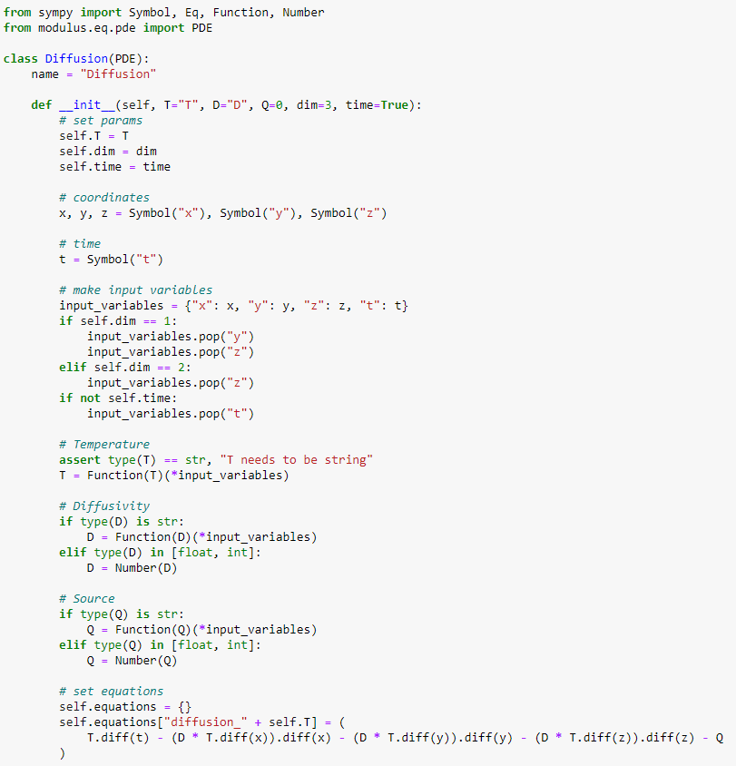
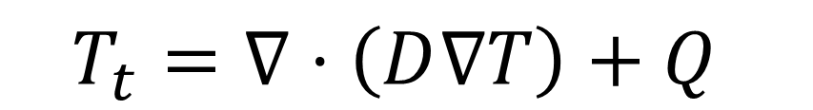
Solution to 1D diffusion
Code snippets – Custom symbolic PDE
Create a child class from Modulus’ PDE class
Add the __init__() function to define any PDE specific arguments
Symbolic input variables using sympy’s Symbol
Dependent variables defined using sympy’s Function
Any additional terms that potentially need to be parameterized can also be specified as dependent variables
Symbolic PDE. Derivatives are computed using sympy’s functions
$$T_{t}=∇⋅\left(D∇T\right)+Q$$
Notes:
Now let’s look at a few specifics in the code. Before we jump in the constraint definition, lets look at the symbolic PDE definition which we skipped during our introductory example explanation.
Any custom PDE in Modulus can be defined by making a child class from Modulus’s PDE class. You can then add any arguments for your PDE by adding them to the __init__ function. Once the appropriate arguments and constants are defined, you can start defining the PDE. First, we define the input variables x,y,z and t with Sympy symbols. Then we define the functions for T, D and Q that are dependent on the input variables (x,y,z,t). Making D and Q as functions of x, y, z, t will later allow us to parameterize any of these quantities for a parameterized simulation. Now using these symbolic variables, we can write out our 3D transient diffusion equation. We store this equation in the class by adding it to the dictionary of equations.
Note that we moved all the terms of the PDE to LHS. This way, while using the equations in the constraints, we can assign a desired residual for this key- which in most cases is 0. You can also assign a custom source function to the ’diffusion_T’ key instead of 0 to add more source terms to our PDE.

Slide 29
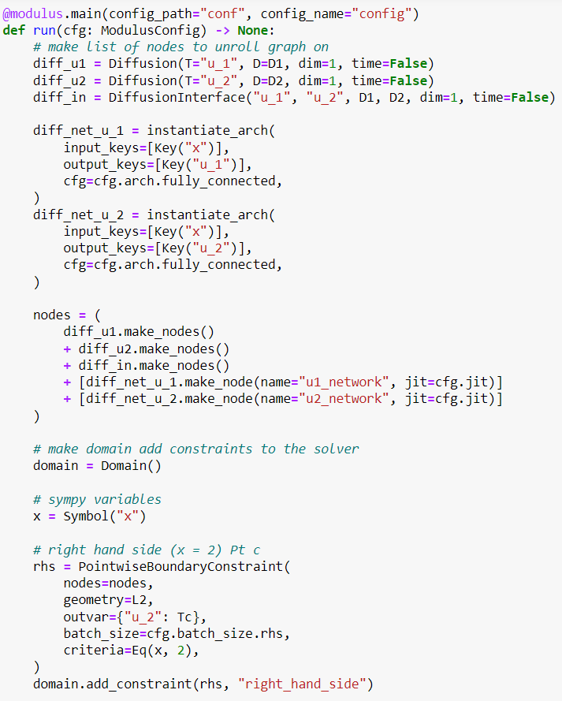
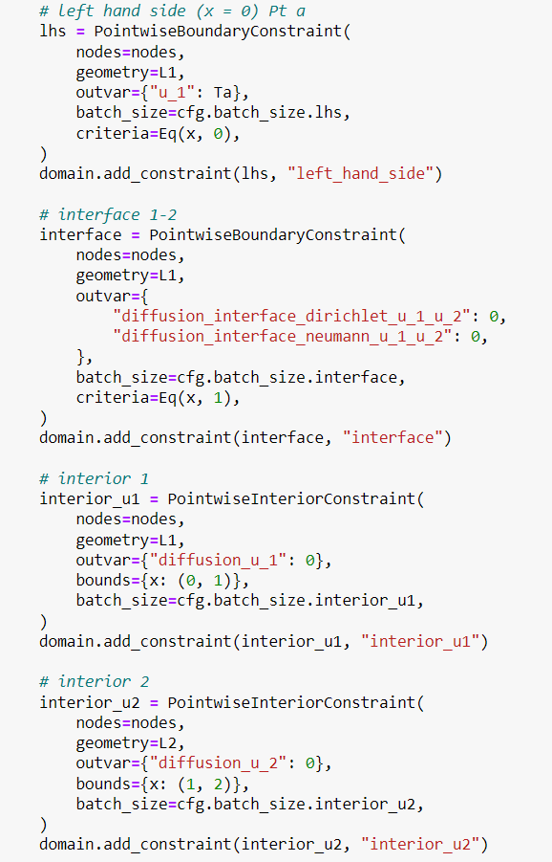
Solution to 1D diffusion
Code snippets
Loading hydra configs
Sample the boundary of geometry
Equation and neural network nodes
Criteria for sub-sampling
Sample the interior of geometry
Domain and Constraints
Notes:
The rest of the structure is very similar to what we saw earlier in the introductory example. Hence, we will only focus on a few key components. Like before the hydra configs are loaded and the equation and PDE nodes are specified. The two separate networks are defined here as we expect a discontinuity at the interface and splitting the network in two parts like this helps in the training. The constraint definition is similar to the earlier example. Here we use the criteria argument to subsample the different boundary points specifically. The criteria can take in any sympy function as input. Multiple boundaries and interior constraints can be added to the domain with ease.

Slide 30
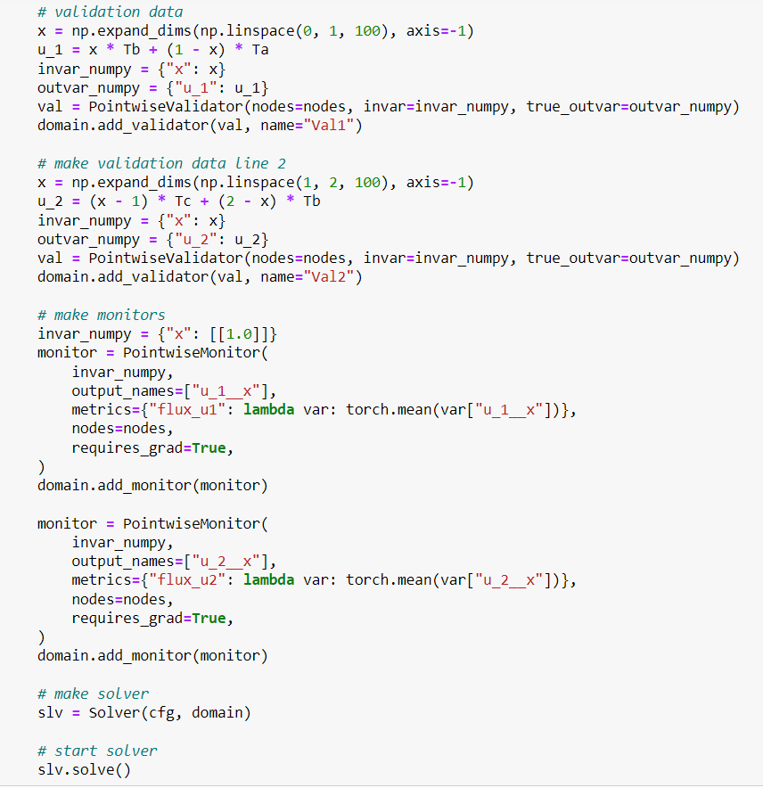
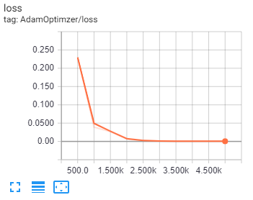
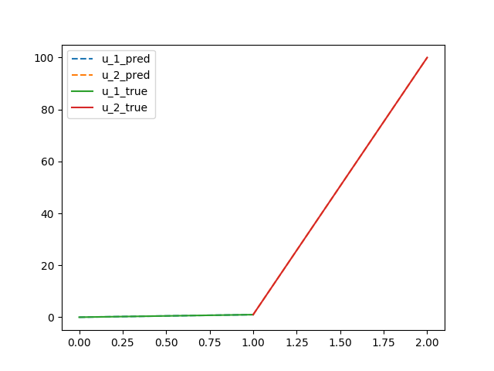
Solution to 1D diffusion
Code snippets
Validators to compare with experimental/analytical
/solver data
Tensorboard visualization of loss curves
Monitor the quantities of interest during the runtime
Solver
Results generated from numpy output
Notes:
Once the constraints are setup, we can add auxiliary training utilities like monitors and validators to do some computations for monitoring during the training. For this example, the analytical solution is known and that can be ingested into the PointwiseValidator class as a dictionary of numpy arrays. Similar is true for Monitors. The monitors can be used to look at the iteration history of the various variables. Finally, the domain and the configs objects are passed to the Solver class and the solve method is called to run the solver and begin the neural network training.
Tensorboard can be used to visualize the various training objectives/constraints as the training progresses to monitor for convergence and accuracy. Visualizing individual losses is also possible. The output results (npz or VTK format) can easily be visualized using plotting tools like Paraview, matplotlib, etc. Here we can see that once the training is complete you can plot the numpy output of the validators and compare it with true solution. We can observe that the neural network prediction matches very closely with the analytical solution.

Slide 31
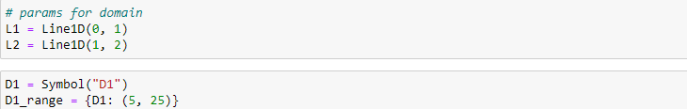
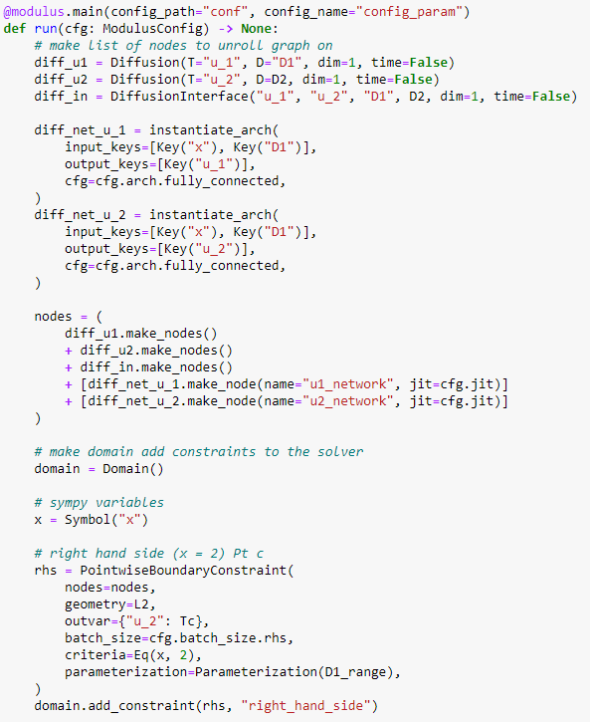
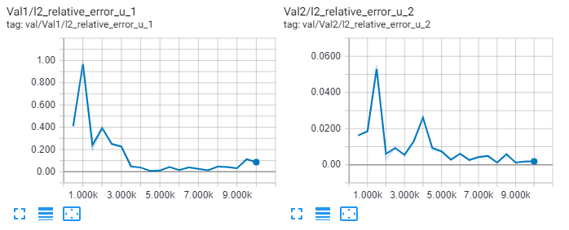
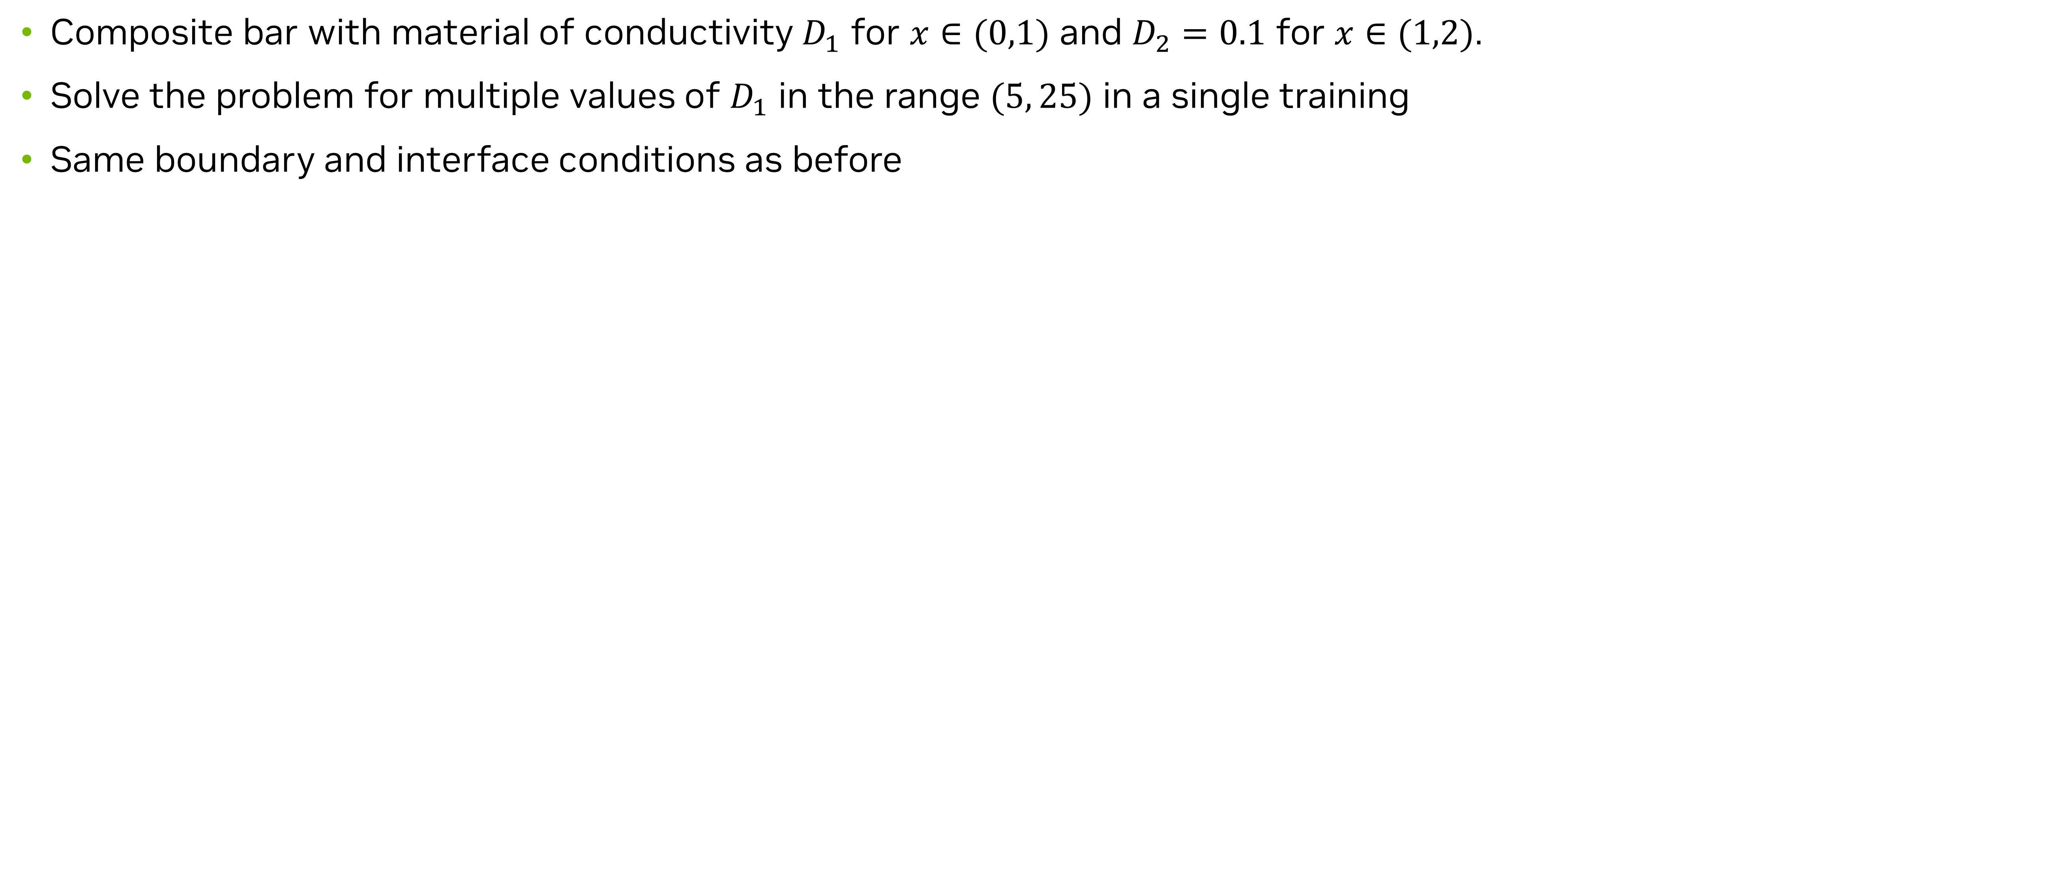
Parameterized Solution to 1D diffusion
Problem description and code snippets
Composite bar with material of conductivity $D_{1}$ for $x∈(0,1)$ and $D_{2}=0.1$ for $x∈(1,2)$.
Solve the problem for multiple values of $D_{1}$ in the range $(5, 25)$ in a single training
Same boundary and interface conditions as before
Symbolically parameterize the variables of choice (geometric/physical) and setup the architecture
Specify the appropriate parameterization to the constraints
Validation error for $D_{1}=10$
Fairly simple changes to go from single forward simulation to parameterized simulation
Notes:
As we discussed in the introductory notebook, one important advantage of a PINN solver over traditional numerical methods is its ability to solve parameterized geometries and PDEs. This provide a significant computational advantage, as one can now use PINNs to solve for multiple designs/cases in a single training. Once the training is complete, it is possible to run inference on several geometry/physical parameter combinations as a post-processing step, without solving the forward problem again.
To demonstrate the concept, we will train the same 1d diffusion problem, but now by parameterizing the conductivity of the first bar in the range (5, 25). Once the training is complete, we can obtain the results for any conductivity value in that range saving us the time to train multiple models.
The definition of equations remain the same for this part. Since earlier while defining the equations, we already defined the constants and coefficients of the PDE to be either numerical values or strings, this will allow us to parameterize D1 by passing it as a string while calling the equations and making the neural network.
We will create the symbolic variable for the D1​ and also specify the range of variation for the variable. While the simulation runs, we will validate it against the same diffusion coefficient that we solved earlier i.e. D1​=10.
For training the parameterized model, we will have the symbolic parameters we just defined as inputs to both the neural networks in diff_net_u_1 and diff_net_u_2 viz. 'D1' along with the usual x coordinate. The outputs remain the same as what we would have for any other non-parameterized simulation.
Adding the constraints is very similar to the non-parameterized version. The symbolic variables and the ranges that we described earlier need to be inputted to the parameterization argument of each boundary and internal constraints (PointwiseBoundaryConstraint and PointwiseInteriorConstraint)
The .npz arrays can be plotted similar to previous section to visualize the output of the simulation. You can see that we get the same answer as the analytical solution. You can try to run the problem in eval mode by changing the validation data and see how it performs for the other D1 values as well. To run the model in evaluation mode (i.e. without training), you just need to modify the config file. You will see that at a fractional increase in computational time, we solved the PDE for D1​ ranging from (5, 25). This concept can easily be extended to more complicated problems and this ability of solving parameterized problems comes very handy during design optimization and exploring the design space. For more examples of solving parameterized problems, please refer to Modulus User Documentation

Slide 32
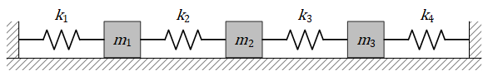
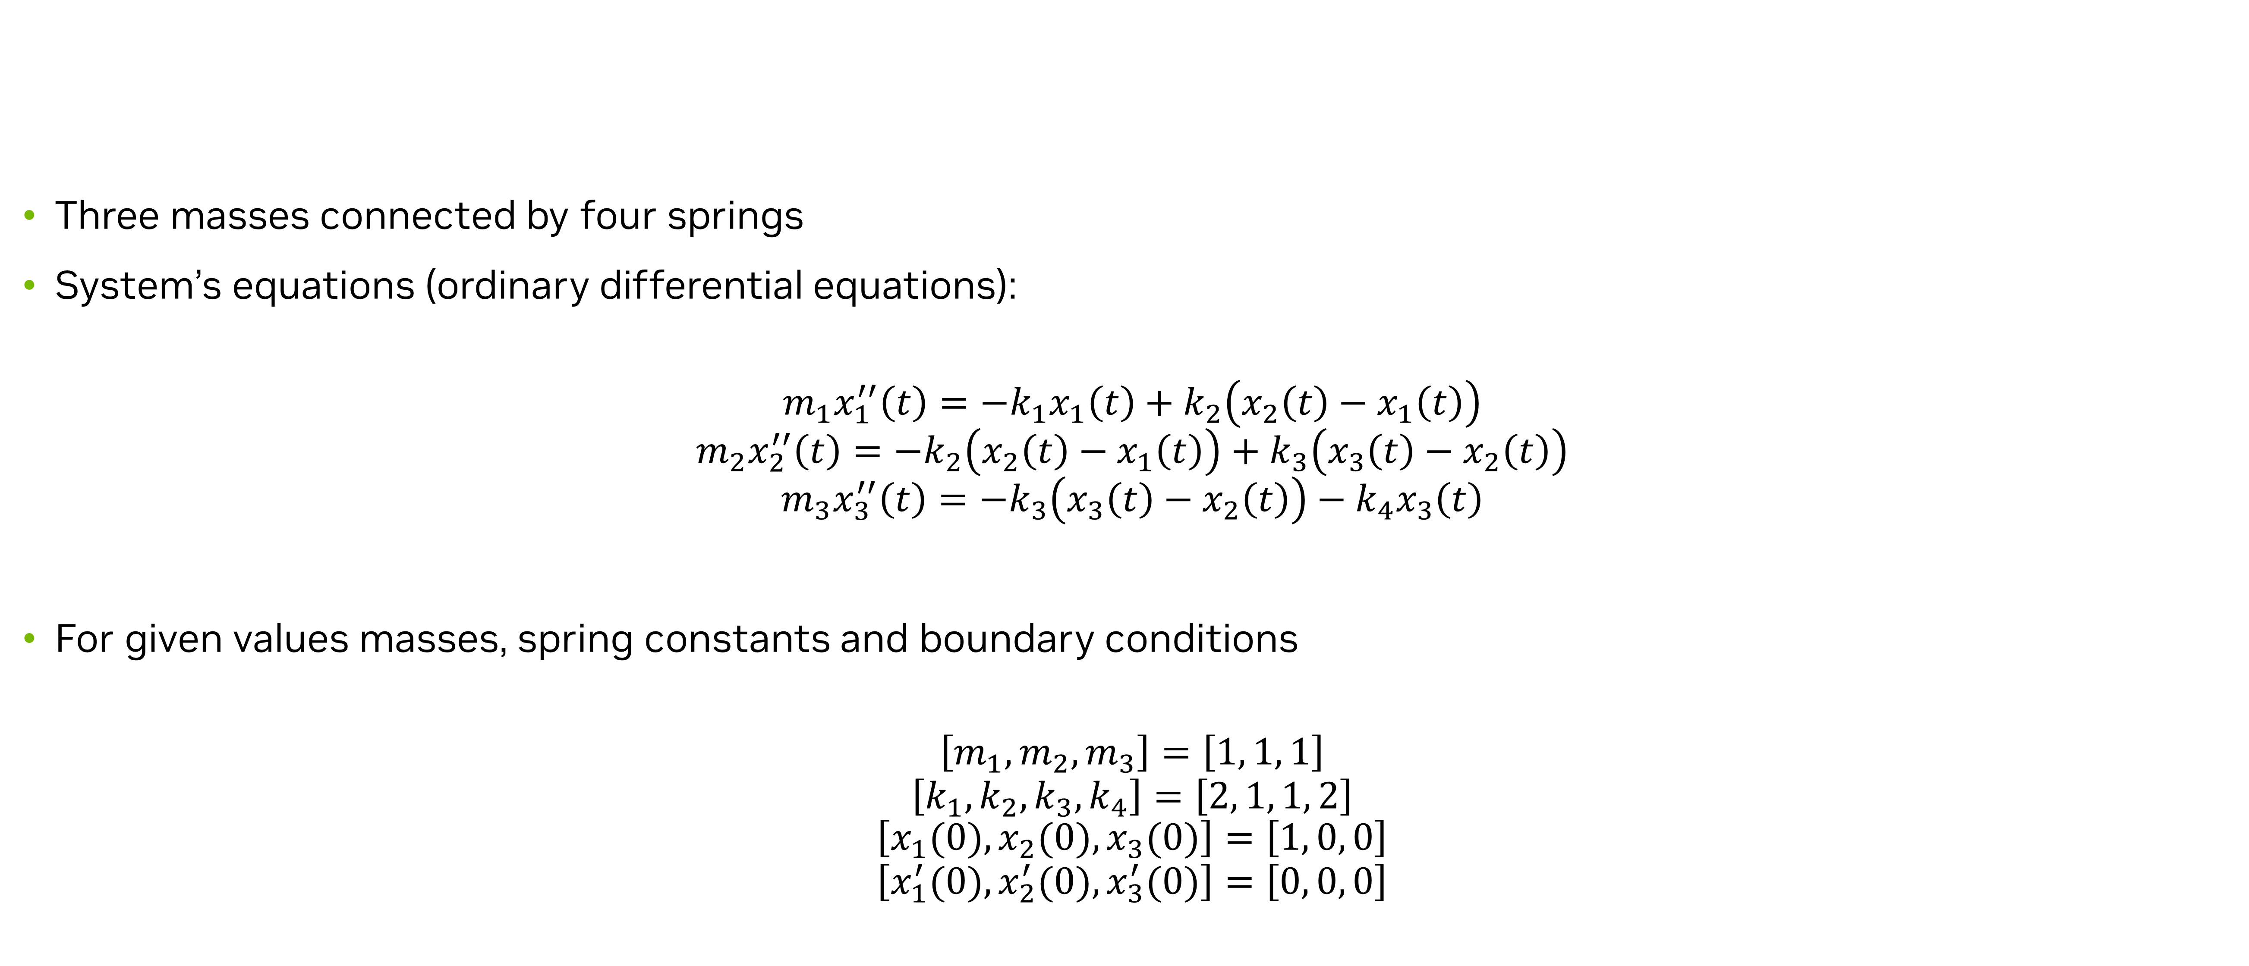
Solution to ODEs – Coupled Spring Mass System
Problem description
Three masses connected by four springs
System’s equations (ordinary differential equations):
$$m_{1}x_{1}^{′′}\left(t\right)=−k_{1}x_{1}\left(t\right)+k_{2}\left(x_{2}\left(t\right)−x_{1}\left(t\right)\right)$$
$$m_{2}x_{2}^{′′}\left(t\right)=−k_{2}\left(x_{2}\left(t\right)−x_{1}\left(t\right)\right)+k_{3}\left(x_{3}\left(t\right)−x_{2}\left(t\right)\right)$$
$$m_{3}x_{3}^{′′}\left(t\right)=−k_{3}\left(x_{3}\left(t\right)−x_{2}\left(t\right)\right)−k_{4}x_{3}\left(t\right)$$
For given values masses, spring constants and boundary conditions
$$\left[m_{1}, m_{2}, m_{3}\right]=\left[1, 1, 1\right]$$
$$\left[k_{1}, k_{2}, k_{3}, k_{4}\right]=\left[2, 1, 1, 2\right]$$
$$\left[x_{1}(0), x_{2}(0), x_{3}(0)\right]=\left[1, 0, 0\right]$$
$$\left[x_{1}^{′}(0), x_{2}^{′}(0), x_{3}^{′}(0)\right]=\left[0, 0, 0\right]$$
Notes:
Now we move to the next application of PINNs. In this example we will solve the system of ordinary differential equations that define a coupled spring mass problem. In this example we will see how to solve the transient problems over small time intervals easily by treating time as a continuous variable. We will also use PINNs to solve the problem in an inverse setting where we have the solution data, and we use PINN to find the coefficient of the ODE.
We will solve a simple spring mass system as shown in figure below. The systems shows three masses attached to each other by four springs. The masses slide along a friction-less horizontal surface. The masses are assumed to be point masses and the springs are mass-less. The model’s equations are shown here. Here, x1​(t), x2​(t), and x3​(t) denote the mass positions along the horizontal surface measured from their equilibrium position, positive right and negative left. As shown in the figure, first and the last spring are fixed to the walls.
For the forward solution part, we will also assume the following initial conditionss.

Slide 33
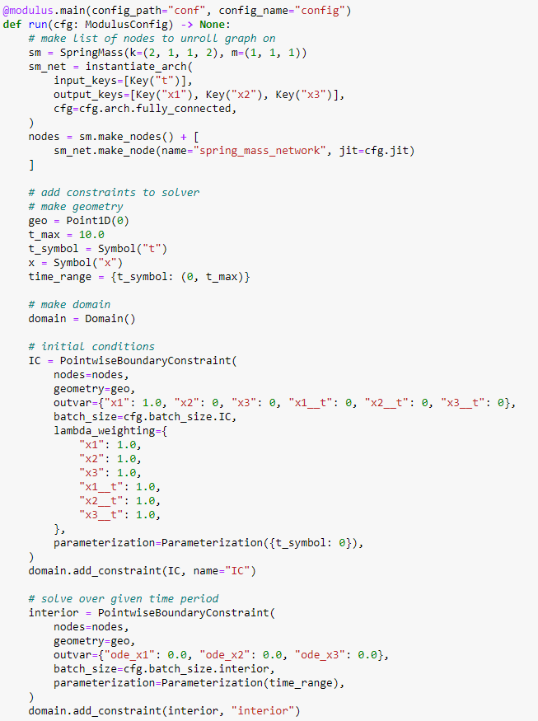


Solution to ODEs – Coupled Spring Mass System
Code snippets
Nodes for a simple transient problem using continuous time approach
Under continuous time approach, time can be modeled as any other parametrized variable
Validation error for each mass
Simple transient problem using continuous time approach. Advanced approaches like moving-time-window etc. also available for more complex problems.
Notes:
We can define the ODEs symbolically like we have seen earlier. Once we have the ODEs defined, we can easily form the constraints needed for optimization. This example, uses Point1D geometry to create the point mass. We will also have to define the time range of the solution and create symbol for time ($t$) to define the initial condition, etc. in the domain. The below code shows the geometry definition for this problem. Note that this tutorial does not use the x-coordinate ($x$) information of the point, it is only used to sample a point in space. The point is assigned different values for variable t only (initial conditions and ODEs over the time-range). The code to generate the nodes and relevant constraints is shown. Note that under the continuous time approach, the problem setup looks very similar to any other parameterized problem. Other advanced approaches to solve more complex transient dynamics are also available like the moving time window approach.

Slide 34

Inverse Problem – Coupled Spring Mass System
Problem description
For the same system, assume we know the analytical solution which is given by:
$$x_{1}\left(t\right)=\frac{1}{6}\cos\left(t\right)+\frac{1}{2}\cos\left(\sqrt{3}t\right)+\frac{1}{3}\cos\left(2t\right);$$
$$x_{2}\left(t\right)=\frac{2}{6}\cos\left(t\right)−\frac{1}{3}\cos\left(2t\right) ;$$
$$x_{3}\left(t\right)=\frac{1}{6}\cos\left(t\right)−\frac{1}{2}\cos\left(\sqrt{3}t\right)+\frac{1}{3}cos⁡(2t)$$
With the above data and the values for $m_{2}, m_{3},k_{1},k_{2},k_{3}$ same as before, use the neural network to find the values of $m_{1}$and $k_{4}$
Notes:
Next, we will look at the ability of PINNs to solve inverse problems. In an inverse problem, we start with a set of observations and then use those observations to calculate the causal factors that produced them. To demonstrate this concept, we will solve the same spring mass system in an inverse setting. More specifically, we will assume that the data for the displacements of the 3 masses x1​,x2​ and x3​ is available to us through analytical solution and the first mass ($m_1$) and the last spring coefficient ($k_4$) is unknown. We will use the neural network to assimilate the displacements from the analytical solution and use it to invert out the unknown quantities from ODEs.

Slide 35



Inverse Problem – Coupled Spring Mass System
Code snippets
Assimilate the data using PointwiseConstraint
Analytical data
Monitors to infer the inverted quantities
Additional network to invert out the unknowns
Results
Notes:
Since part of the problem involves memorizing the given solution, we will have 't' as input numpy array and 'x_1', 'x_2', 'x_3’, as the output numpy arrays. Additionally, we will create 'ode_x1', 'ode_x2', 'ode_x3’ to enforce the equation loss at these points. Setting 'x_1', 'x_2', 'x_3' as input values from analytical data, we are essentially making the network assimilate the analytical distribution of these variables in the selected domain. Setting 'ode_x1', 'ode_x2', 'ode_x3' equal to 0, we will also inform the network to satisfy the ODE losses at those sampled points. Now, assuming that we also know the initial conditions of the solution, except the 'm_1' and 'k_4', all the variables in these ODEs are known. Thus, the network can use this information to invert out the unknowns.
The process of creating neural networks for an inverse problem is similar to other problems we have seen in previous tutorials. However, as the information for the displacements, and in turn their gradients (i.e. velocities and accelerations), is already present (from analytical data) for the network to memorize, we will detach these variables in computation graph in their respective equations. This means that only the networks predicting 'm1' and 'k4' will be optimized to minimize the equation residuals. The displacements, velocities and accelerations are treated as ground truth data.
For this problem, we will use the solution coming from analytical solution in from of numpy arrays we defined earlier. We will use the PointwiseConstraint class to handle such input data. The PointwiseConstraint class takes in separate dictionaries for input variables and output variables. These dictionaries have a key for each variable and a numpy array of values associated to the key. The below code shows the addition of the boundary constraint and the constraint coming from the numpy arrays we just defined.
For this tutorial, we will monitor the convergence of average 'm_1' and 'k_4' inside the domain as the solution progresses. Once we find that the average value of these quantities have reached a steady value, we can end the simulation. The code to generate such monitors can be found below. We can monitor the Tensorboard plots to see the convergence of the simulation and the final values of the m1​ and k4​. We see that after sufficient training, we get the m1​ and k4​ as 1 and 2 respectively. These were the same values that we used to create the analytical solution.

Slide 36

Data-driven analysis – Surrogate Model for Darcy Flow
Problem description
Use Fourier Neural Operator (FNO) and its variants to develop a surrogate model that learns a mapping between a permeability field and pressure field, $K→U$, for a distribution of permeability fields $K\sim p(K)$.
The Darcy PDE is a second order, elliptical PDE with the following form:
$$−∇⋅\left( k\left(x\right)∇ u\left(x\right)\right) = f\left(x\right), x∈ D,$$
Where $u(x)$ is the flow pressure, $k(x)$ is the permeability field and $f(⋅)$ is the forcing function.
The Darcy flow can parameterize a variety of systems including flow through porous media, elastic materials and heat conduction.
Here, we will define the domain as a 2D unit square $D= \{x, y∈ \left(0,1\right)\}$ with the boundary condition $u(x)=0$, $x∈∂D$.
Both the permeability and flow fields are discretized into a 2D matrix $K, u∈ℝ^{N×N}$.
Notes:
That completed our Physics-informed training aspects using Modulus. Next, will start looking into the data-driven training.
For all the data-driven setups we will consider henceforth, we will consider a darcy flow problem. The goal is to develop a surrogate model that learns the mapping between a permeability field and the pressure field, i.e. a map between K and U (K→U), for a distribution of permeability fields K∼p(K). In this problem, we are not learning just a single solution but rather a distribution.
The Darcy PDE is a second order, elliptic PDE with the form shown here. Here, u(x) is the flow pressure, k(x) is the permeability field and f(⋅) is the forcing function. The Darcy flow can parameterize a variety of systems including flow through porous media, elastic materials and heat conduction. Here, we will define the domain as a 2D unit square D={x,y∈(0,1)} with the boundary condition u(x)=0,x∈∂D. Both the permeability and flow fields are discretized into a 2D matrix K,U∈RN×N.

Slide 37


Darcy Flow – Fourier Neural Operators (FNO)
Theory
FNO can be used to parameterize solutions for a distribution of PDE solutions. The key feature of FNO is the spectral convolutions: operations that place the integral kernel in Fourier space:​
$$\left(K\left(w\right)φ\right)\left(x\right)=F^{−1}\left(R_{W}⋅\left(F\right)φ\right)\left(x\right), ∀x∈D$$
$R_{w}$ is the transformation containing the learnable parameters $w$. This operator is calculated over the entire structured Euclidean domain $D$. Fast Fourier Transform (FFT) is used to perform the Fourier transforms efficiently and the resulting transformation $R_{w}$ is a finite size matrix of learnable weights. ​
In spectral convolution, the Fourier coefficients are truncated to only the lower modes which allows explicit control over the dimensionality of the spectral space and linear operator.​
The FNO model is a composition of a fully-connected “lifting” layer, $L$ spectral convolutions with point-wise linear skip connections and a decoding point-wise fully-connected neural network at the end:​
$$u_{net}\left(Φ:θ\right)=Q∘σ\left(W_{L}+K_{L}\right)∘…∘σ\left(W_{1}+K_{1}\right)∘P\left(Φ\right), Φ=\{φ\left(x\right);∀x∈D\}$$
Here, $σ(W_{i}+K_{i})$ is the spectral convolution layer $i$ with the point-wise linear transform $W_{i}$ and activation function $σ(⋅)$. $P$ is the point-wise lifting network that projects the input into a higher dimensional latent space. Q is the point-wise fully-connected decoding network. ​
Since all fully-connected components of FNO are point-wise operations, the model is invariant to the dimensionality of the input. ​
Source: Li et al., 2010.08895.pdf (arxiv.org)
Notes:
A little bit of theory on the Fourier Neural Operators. The key feature of Fourier Neural Operators, or FNOs is the spectral convolutions. Operations that take place in the integral kernel in Fourier space. The Fourier layer consists of three steps:
Take the fourier transform of the input
Do a Linear transform on the lower Fourier modes R
Take the inverse Fourier transform
The output of the fourier layer is then added with the bias term W which is a linear transformation. Finally, an activation activation function \sigma is applied. Simple as it is.
In practice, it’s usually sufficient to only take the lower frequency modes and truncate out these higher frequency modes. Therefore, the linear transformation is applied on the lower frequency modes and set the higher modes to zeros. That should give you a good high-level understanding of the fourier layer. The FNO model is a composition of a fully connected “lifting layer”, L spectral convolutions with point-wise linear skip connections and a decoding point-wise fully-connected neural network at the end. Since all the fully-connected components of FNO are point-wise operations, the model is invariant to the dimensionality of the input.
For more details, please refer the paper by Li and colleagues.

Slide 38



Darcy Flow – Fourier Neural Operators (FNO)
Code Snippets
Lazy data loading (in addition to eager loading) available for large datasets
Instantiate the FNO model. Network parameters handled in configs.
Hydra configs for the Darcy FNO problem
Notes:
Now let’s look at how to use FNOs in Modulus. For this data-driven problem, the first step is to get the training data into Modulus. Prior to loading data, we can set any normalization value that we want to apply to the data. For this dataset, we calculated the scale and shift parameters for both the input permeability field and output pressure. Then, we set this normalization inside Modulus by providing the scale/shift to each key, Key(name, scale=(shift, scale)). There are two approaches for loading data: First, use eager loading where you immediately read the entire datast into memory at one time. Alternatively, you can use lazy loading where the data is loaded on a per example basis as the model needs it for training. The eager loading eliminates potential overhead from reading data from disc during training, however this cannot scale to large datasets. Lazy loading is used in this example for both the training and test datasets to demonstrate this utility for larger problems.
Initializing the model and domain follows the same steps as the other PINN models we saw earlier.
Using Hydra to manage the configs of the models makes hyper parameter tuning very easy. This is an essential part for the data-driven machine learning.

Slide 39

Darcy Flow – Fourier Neural Operators (FNO)
Code Snippets
Note
The constraint will construct the data loader automatically.
Modulus constraints can instantly be scaled to multi-node/multi-GPU training.
Optimizations such as torch script/CUDA graphs will be performed under-the-hood.
Batch size is controlled in the Hydra configuration file.
These are the two core components of setting up basic data-driven problem in Modulus.
Supervised grid constraints
Grid Validators
Notes:
For the physics-informed problems in Modulus, we typically need to define a geometry and constraints based on boundary conditions and governing equations. Here, the only constraint is a SupervisedGridConstraint which performs standard supervised training on grid data. This constraint supports the use of multiple workers, which are particularly important when using lazy loading. We can then add the validation data to the domain using GridValidator which should be used when dealing with structured data.
Note: Grid data refers to data that can be defined in a tensor like an image. Inside Modulus, this grid of data typically represents a spatial domain and should follow the standard dimensionality of [batch, channel, xdim, ydim, zdim] where channel is the dimensionality of your state variables. Both Fourier and convolutional models use grid-based data to efficiently learn and predict entire domains in one forward pass, which contrasts to the pointwise predictions of standard PINN approaches

Slide 40

Darcy Flow – Fourier Neural Operators (FNO)
Results and discussion
FNO accurately learns the solution of this system.
Modulus supports the visualization of results through images (matplotlib), Tensorboard, VTK files and Omniverse for select problems.
For more information, please refer to the official Modulus user guide example.
Notes:
You can see that the model is able to accurately predict the pressure field for permeability fields it had not seen previously. These visualizations can also be viewed during the training using the Tensorboard.
Modulus supports visualization of results via images (matplotlib), Tensorboard, VTK files and Omniverse extension for select problems. For more details and information, please refer the official user guide.

Slide 41

Darcy Flow – Adaptive Fourier Neural Operators (AFNO)
Theory
AFNO combines the Fourier Neural Operator (FNO) with the powerful Vision Transformer (ViT) model for image processing. The ViT and related variants of transformer models have achieved SOTA performance in image processing tasks. The multi-head self-attention (MHSA) mechanism of the ViT is key to its impressive performance. ​
The first step in the architecture involves dividing the input image into a regular grid with $h×w$ equal sized patches of size $p×p$. The parameter $p$ is referred to as the patch size. For simplicity, we consider a single channel image. Each patch is embedded into a token of size d, the embedding dimension. The patch embedding operation results in a token tensor $(X_{h×w×d})$ of size $h×w×d$. The patch size and embedding dimension are user selected parameters. A smaller patch size allows the model to capture fine scale details better while increasing the computational cost of training the model. A higher embedding dimension also increases the parameter count of the model. The token tensor is then processed by multiple layers of the transformer architecture performing spatial and channel mixing. The AFNO architecture implements the following operations in each layer.​
The token tensor is first transformed to the Fourier domain with​
$$Z_{m,n}={\left[DFT\left(X\right)\right]}_{m,n}$$
Here, $m,n$ is the index the patch location and DFT denotes a 2D discrete Fourier transform. ​
Notes:
Now let’s look at another Data-driven model in Modulus. This one is called the Adaptive Fourier Neural Operators, or AFNO. In contrast with the Fourier Neural Operator which has a convolutional architecture, the AFNO leverages contemporary transformer architectures in the computer vision domain. Vision transformers have delivered tremendous success in computer vision. This is primarily due to effective self-attention mechanisms. To cope with this challenge, Guibas et al. proposed Adaptive Fourier Neural Operator (AFNO) as an efficient attention mechanism in the Fourier Domain. AFNO is based on principled foundation of operator learning which allows us to frame attention as a continuous global convolution efficiently in the Fourier domain. To handle challenges in vision such as discontinuities in images and high resolution inputs, AFNO proposes principled architectural modifications to FNO which results in memory and computational efficiency. This includes imposing a block-diagonal structure on the channel mixing weights, adaptively sharing weights across tokens, and sparsifying the frequency modes via soft-thresholding and shrinkage.
The AFNO model typically inculdes the following steps:
Dividing the input image into a regular grid with h×w equal sized patches of size p×p.
Embed the patch into a token of size d, the embedding dimension resulting in a token tensor ($X_{h\times w \times d}$) of size h×w×d.
Pass the token through multiple layers of transformer architecture performing spatial and channel mixing.
At the end of all the transformer layers, convert the feature tensor back to image space using a linear decoder.
The detailed description of the AFNO model is beyond the scope of this material and you are encouraged to look at the original paper for more details.

Slide 42



Darcy Flow – Adaptive Fourier Neural Operators (AFNO)
Code Snippets
Lazy loading like FNO example
Crop the data to make divisible by patch size
Constraints and Validators same as FNO example.
Without any changes to the core constraint/validator, experiment with different architectures with ease
Notes:
The process of setting the AFNO training is very similar from a case setup standpoint hence we will only highlight the important differences wherever necessary.
The AFNO is based on the ViT transformer architecture and requires tokenization of the inputs. Here each token is a patch of the image with a patch size defined in the configuration file through the parameter patch_size. The embed_dim parameter defines the size of the latent embedded features used inside the model for each patch.
Loading both the training and validation datasets into memory follows a similar process as seen in the FNO. The inputs for AFNO need to be perfectly divisible by the specified patch size (in this case, patch_size=16), which is not the case for this dataset. Therefore, we trim the input/output features such that they are have appropriate dimensionality 241x241 -> 240x240
Rest of the constraints and the validators etc. remains very similar to what we have seen earlier. Thus, Without any changes to the core constraint/validator, experiment with different architectures with ease.

Slide 43


Darcy Flow – Adaptive Fourier Neural Operators (AFNO)
Results and discussion
AFNO accurately learns the solution of this system.
For more information, please refer to the official Modulus user guide example.
AFNO is the key backboard for NVIDIA’s groundbreaking FourCastNet:
Notes:
The results of the model after training are shown here. It is important to recognize that AFNO's strengths lie in its ability to scale to a much larger model size and datasets than what is used in this example. While not illustrated here, this example demonstrates the fundamental implementation of data-driven training using the AFNO architecture in Modulus for you to extend to larger problems. AFNO is key backboard for the NVIDIA’s groundbreaking FourCastNet.

Slide 44
Darcy Flow – Physics Informed Neural Operators (PINO)
Theory
PINO incorporates a PDE loss to the Fourier Neural Operator. This improves interpretability and reduces the amount of data required to train a surrogate model, since the PDE loss constrains the solution space. ​
In general, the PDE loss involves computing the PDE operator which in turn involves computing the partial derivatives of the Fourier Neural Operator ansatz, which is nontrivial. The key set of innovations in the PINO are the various ways to compute the partial derivatives of the operator ansatz. The PINO framework implements the differentiation in three different ways.​
Numerical differentiation using a finite difference Method (FDM).​
Numerical differentiation computed via spectral derivative.​
Hybrid differentiation based on a combination of first-order “exact” and second-order FDM derivatives.​
Notes:
Now let’s look at the final model that cominees data with physiscs. The PINO approach for surrogate modeling of PDE systems effectively combines the data-informed supervised learning framework of the FNO with the physics-informed learning framework. The PINO incorporates a PDE loss to the Fourier Neural Operator. This reduces the amount of data required to train a surrogate model, since the PDE loss constrains the solution space. The PDE loss also enforces physical constraints on the solution computed by a surrogate ML model, making it an attractive option as a verifiable, accurate and interpretable ML surrogate modeling tool.
To explain the key concepts behind PINO, consider a stationary PDE system. IN this example, we consider the same Darcy PDE.
In the FNO framework, the surrogate ML model is given by a the solution operator which maps any given coefficient in the coefficient space to the solution. The FNO is trained in a supervised fashion using training data in the form of input-output pairs. The training loss for the FNO is then given by summing the data loss, over all training pairs.
In the PINO framework, the solution operator is optimized with an additional PDE loss which is computed over independent and identically distributed samples from an appropriate supported distribution in parameter/coefficient space.
In general, the PDE loss involves computing the PDE operator which in turn involves computing the partial derivatives of the Fourier Neural Operator ansatz. In general, this is nontrivial. The key set of innovations in the PINO paper are the various ways to compute the partial derivatives of the operator ansatz, viz:
Numerical differentiation using a Finite-Difference Method (FDM).
Numerical differentiation computed via spectral derivative.
3. Hybrid differentiation based on a combination of first-order "exact" derivatives and second-order FDM derivatives.
For more details, please refer the Modulus User Documentation and the original paper by Li and colleagues.

Slide 45


Darcy Flow – Physics Informed Neural Operators (PINO)
Code snippets
Setting up a PINO problem in Modulus requires setting up a custom PDE loss that can compute on grid data. Readers are referred to the supplemental Jupyter notebooks for the code snippets for the Loss definition.
Load additional gradients for the loss calculation
Additional nodes for physics loss
Loss for physics constraint
Notes:
The key difference between PINO and FNO is that PINO adds a physics-informed term to the loss function of FNO.
In Modulus, three different methods for computing the derivatives are provided. These are based on the original PINO paper:
Numerical differentiation computed via Finite-Difference Method (FDM)
Numerical differentiation computed via spectral derivative
Hybrid differentiation based on a combination of first-order "exact" derivatives and second-order FDM derivatives
The first 2 approaches are the same as proposed in the original paper. The third approach is a modification of the "exact" approach proposed in the paper. This method is slower and more memory intensive than the numerical derivative approaches when computing second order derivatives because it requires the computation of a Hessian matrix. Instead, a "hybrid" approach is provided which offers a compromise by combining first-order "exact“ derivatives and second-order FDM derivatives. Note: the exact method is not technically exact because it uses a combination of numerical spectral derivatives and exact differentiation, see original paper for more details.
Now considering the problem setup, it is largely the same as the FNO example, except that the PDE loss is defined and the FNO model is constrained using it. The definition of the PDE loss can be found in the supplemental Jupyter notebooks. Here we see that we specify some additional keys for gradient and loss calculation and some additional nodes are specified for the physics loss.

Slide 46



Darcy Flow – Physics Informed Neural Operators (PINO)
Code snippets and results and discussion
Results. Left: Inputs to the model (Input permeability and its gradients), Right: Model prediction and its comparison with true solution
Constraints and Validators same as FNO example.
Without any changes to the core constraint/validator, experiment with different architectures with ease
Benefit of PINO is seen in “small data” regimes where the PDE loss regularizes the model giving better prediction than FNO when trained with only 100 samples.
Notes:
Constraints and Validators same as FNO example. As seen before, without any changes to the core constraint/validator, we can experiment with different architectures with ease. The results of the model prediction are also shown here.
The Tensorboard plot below compares the validation loss of PINO (all three gradient methods) and FNO. You can see that with large amounts of training data (1000 training examples), both FNO and PINO perform similarly. A benefit of PINO is that the PDE loss regularizes the model, meaning that it can be more efficient in "small data" regimes. The plot below shows the validation loss when both models are trained with only 100 training examples. In this case, we find that PINO outperforms FNO.

Slide 47
Neural Operators in Modulus
Conclusions
Modulus supports several neural operators (also includes the famous DeepONets) that can easily be used out of the box.
Modulus uses Hydra configuration for easily adjusting hyperparameters and even changing model architectures with minimal changes to Python code.
Data-driven training can quickly be integrated into the Modulus framework.
For more information on supported models and examples please see the Modulus documentation.
Notes:
That completes our discussion on the FNO and its variants in Modulus. To summarize, Modulus supports several neural operators which also includes the famous DeepONets that can easily be used out of the box.
Modulus uses Hydra configuration for easily adjusting hyper-parameters and even changing model architectures with minimal changes to python code.
And Data-driven training can be quickly integrate into Modulus Framework. For more information on supported models and examples, please refer to the Modulus user documentation.

Slide 48





Modulus Features
Constructive Solid Geometry Module – Fully parameterizable with SymPy and allows Boolean ops
Allows to create complex geometries using a variety of primitives (​torus, cones, ellipse, etc.)
Supports functions like translate, rotate, scale, repeat, etc.
Example of a parameterized 3 Fin heatsink and solving the conjugate heat transfer problem.
Boolean (Union, Intersection and, Subtraction) of different primitives within Modulus
Geometry parameterizable using SymPy
Notes:
That completes our overview of data-driven models in Modulus. Now lets look at some of the Modulus features in detail.
Modulus provides a constructive solid geometry module that is fully parametereizable using Sympy and allows Boolean operations. It comes pre-built with several complex primitives like torus, cones, ellipse, etc. for user to choose from. These primitives also support operations like translate, rotate, scale and repeat. This , along with the ability to perform Boolean operations with these shapes allows us to create some fairly complicated shapes like shown here.

Slide 49



Modulus Features
PySDF library: Tessellated Geometry Module, OptiX for sampling and SDF
Allows to import complex tessellated geometries.​
Uses ray tracing to compute SDF and its derivatives. Also computes surface normals.​
Once the geometry is imported, creates a point cloud for training.​
Notes:
Another interesting module is the Modulus’s Tesselation module. It is an integration with NVIDIA’s PySDF library that uses OptiX for sampling and SDF computations. This allows us to import complex tessellated geometries. It uses ray-tracing to compute the SDF and its derivatives. The module also computes the surface normal. Once the geometry is imported, the point cloud can be used for training.

Slide 50





Modulus Features and Advancements
Physics types and solution of differential equations
Physics types:
Linear Elasticity (plane stress, plane strain and 3D)
Fluid Mechanics
Heat Transfer
Coupled Fluid-Thermal
Electromagnetics
Wave propagation
Examples of 2-eqn. turbulence (on fully developed channel case)
Solution of differential equations:
Ordinary Differential Equations
Differential (strong) Form
Integral (weak) form of the PDEs
Linear Elasticity
Electromagnetics
Modulus t=600ms
Conjugate Heat Transfer
Taylor-Green vortex decay
Wave Propagation

Slide 51


Modulus Features and Advancements
Network Architectures
Several neural network architectures:
Fully connected Network
Fourier Feature Network
Sinusoidal Representation Network (SiReN)
Modified Fourier Network
Deep Galerkin Method Network
Modified Highway Network
Multiplicative Filter Networks
Operators:
Fourier Neural Operator (FNO)
Adaptive Fourier Neural Operator (AFNO)
Physics Informed Fourier Neural Operator (PINO)
DeepONet
Comparisons of various networks in Modulus applied to solve the flow over a heatsink
Darcy Flow problem using FNO in Modulus

Slide 52


Modulus Features and Advancements
Other advanced training features
Other Features include:
Support for new optimizers
AdaHessian and up to 30+ optimizers (from PyTorch’s torch_optimizer library)
New algorithms for loss balancing
GradNorm, ReLoBRaLo, Soft Adapt, NTK, etc.
Sobolev (gradient-enhanced) training
Exact boundary condition imposition
Global and local learning rate annealing
Global adaptive activation functions
Halton sequences for low-discrepancy point cloud creation
Gradient Accumulation
Time-stepping schemes for transient problems
Temporal loss weighting and time marching for the continuous time approach
Importance sampling
Homoscedastic task uncertainty quantification for loss weighting
Hydra Configs for easy hyper-parameter tuning
Importance sampling
Handling larger batch sizes using Multi-GPU and/or Gradient Aggregation

Slide 53


Modulus Features and Advancements
Other advanced training features
APIs to automatically generate point clouds from Boolean compositions of geometry primitives or import point cloud for complex geometry (e.g., STL files)
Parameterized system representation that solves several configurations concurrently for analytical geometry using Modulus CSG module
Transfer learning for efficient surrogate-based parameterization of STL and constructive solid geometries
STL geometry and Transfer Learning
Geometry parameterization using Modulus’ CSG module

Slide 54


Omniverse Extension for Modulus
NVIDIA Omniverse™ is an easily extensible platform for 3D design collaboration and scalable multi-GPU, real-time, true-to-reality simulation. Omniverse revolutionizes the way we create and develop as individuals and work together as teams, bringing more creative possibilities and efficiency to 3D creators, developers and enterprises. ​​
Omniverse extension for Modulus enables real-time virtual-world simulation and full-design fidelity visualization. The built-in pipeline can be used for common visualizations such as streamlines and iso-surfaces for the outputs of the Modulus model. Another key feature is being able to visualize and analyze the high-fidelity simulation output in near real time as the design parameters are varied.​
For more information, please refer Modulus Extension Docs

Slide 55
Modulus Resources
Download Now: https://developer.nvidia.com/modulus-downloads​
Webpage: https://developer.nvidia.com/modulus​
Documentation: https://sw-docs-dgx-station.nvidia.com/deeplearning/modulus/index.html​
Developer Forum: https://forums.developer.nvidia.com/c/physics-simulation​
Demos:​
Accelerating Extreme Weather Prediction with FourCastNet​
Siemens Energy HRSG Digital Twin Simulation Using NVIDIA Modulus and Omniverse​
Accelerating Scientific & Engineering Simulation Workflows with AI​
Flow Physics Quantification in an Aneurysm Using NVIDIA Modulus​
Blogs: ​
AI and Machine Learning in Physics​
Using NVIDIA Modulus and Omniverse Wind Farm Digital Twin for Siemens Gamesa (using NVIDIA Modulus and Omniverse)​
Siemens Energy Taps NVIDIA to Develop Industrial Digital Twin of Power Plant in Omniverse and Modulus​
Using Hybrid Physics-Informed Neural Networks for Digital Twins in Prognosis and Health Management​
Using Physics-Informed Deep Learning for Transport in Porous Media​

Slide 56
Modulus Resources
Papers:​
NVIDIA SimNet™: An AI-Accelerated Multi-Physics Simulation Framework​
Physics-Informed Machine Learning and Uncertainty Quantification for Mechanics of Heterogeneous Materials​
Physics Informed RNN-DCT Networks for Time-Dependent Partial Differential Equations
​ Talks:​
A Novel Framework for Physics based Machine Learning in Science & Engineering Domains​
Accelerate HPC Simulations at Scale with Physics-informed Neural Networks and NVIDIA GPUs on AWS​
Toward Developing High Reynolds Number, Compressible, Reacting Flows in Modulus​
Physics-informed Neural Networks for Wave Propagation Using NVIDIA Modulus​
Uncertainty Quantification for Transport in Porous Media Using Parameterized Physics Informed Neural Networks​
Using Physics-Informed Neural Networks and Modulus to Accelerate Product Development​
Physics-Informed Neural Networks for Mechanics of Heterogenous Media​
Hybrid Physics-Informed Neural Networks for Digital Twin in Prognosis and Health Management​
Physics-Informed Neural Network for Flow and Transport in Porous Media​
AI-Accelerated Computational Science and Engineering Using Physics-Based Neural Networks​
Cumulative Damage Models, Hybrid-Physics-Informed Neural Networks, and Digital TwinsWWCumulative Damage Models, Hybrid-Physics-Informed Neural Networks, and Digital Twins​
NVIDIA Modulus - Accelerating Scientific & Engineering Simulation workflows with AI​
Podcast:​
AI Physics Simulation Toolkit SimNet & PINNs​

